Slide 1
Towards Robust Cross-spectral Optical-Thermal SLAM onboard a fixed-wing UAV
Felix Graule
Semester Thesis – Final Talk
Supervised by Prof. Dr. R. Siegwart, Dr. N. Lawrance, T. Hinzmann, F. Achermann

Slide 2
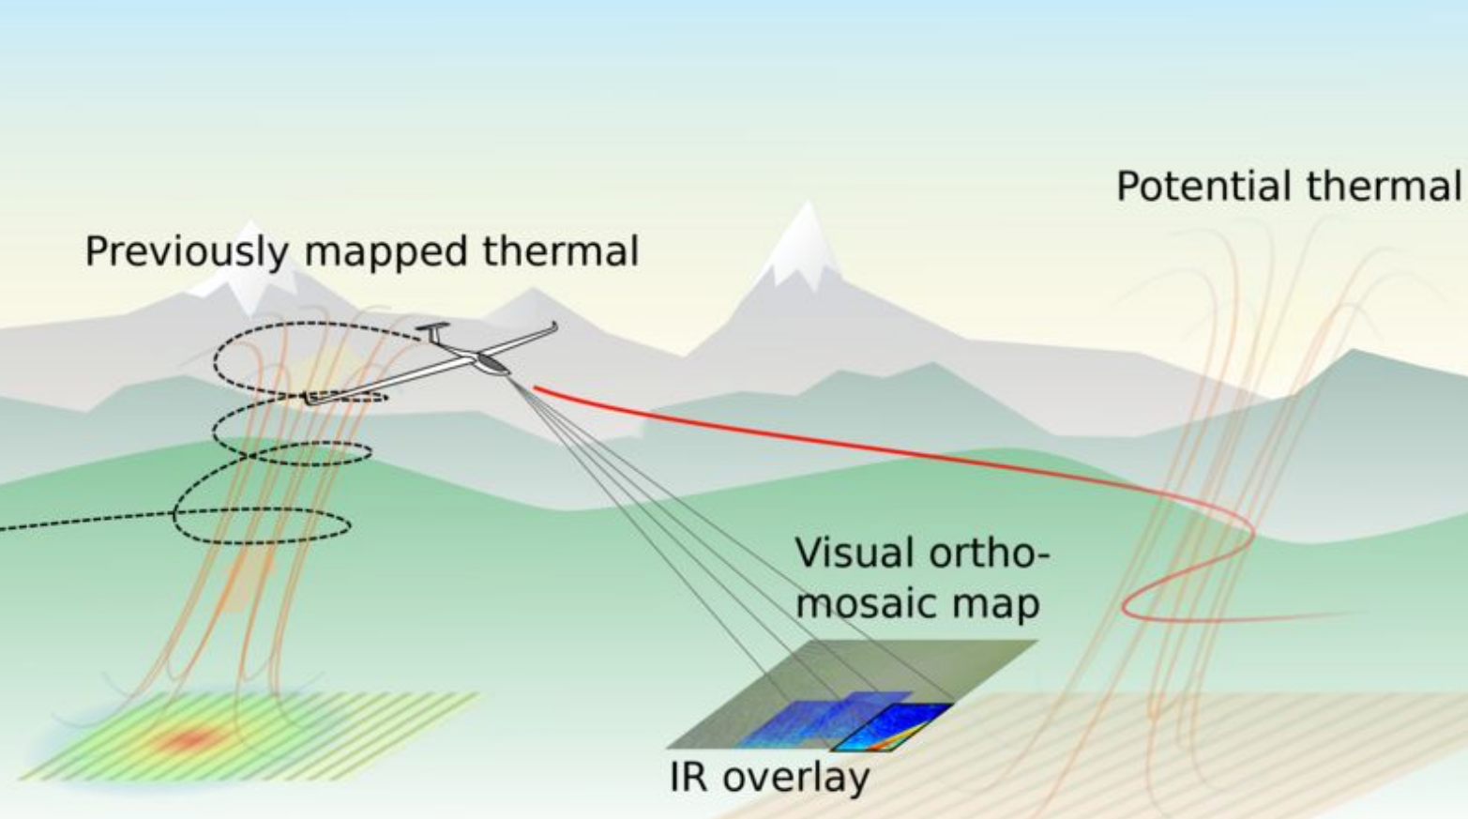
Introduction
Motivation
Platform: Fixed-wing glider UAV with optical and thermal camera
Long-term goals:
  Extend flight duration by autonomously soaring in thermal updrafts
  Flying in bad visual conditions, e.g. at night or in foggy weather
Need consistent, real-time heatmap which is registered to optical map
Figure taken from project description, courtesy of N. Lawrance
Notes:
Updrafts usually appear at spots with high temperature gradients, e.g. forest to field transitions.
For both use cases we need a consistent heatmap that is properly registered / connected to the optical map. Ideally, one would want to generate this map online onboard the aircraft.
Say that no method exists
Have existing optical localization, know how to act based on those, need heatmap to be registered to optical map

Slide 3
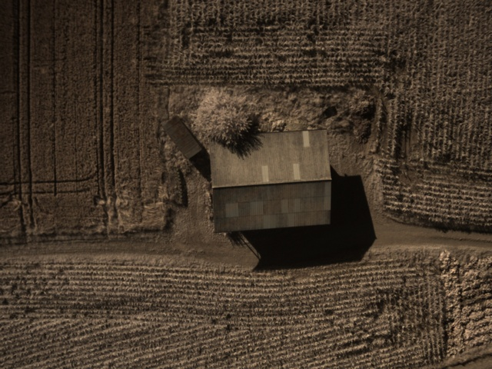
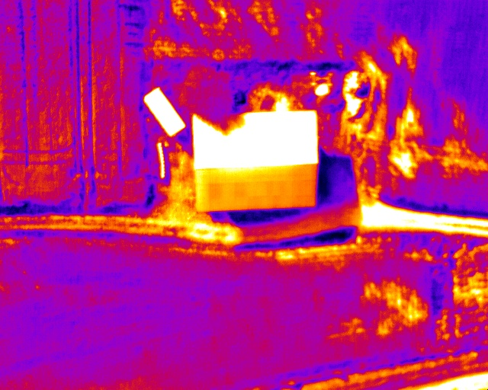
Introduction
Challenges – Example 1
optical
thermal
Loss of texture

Slide 4
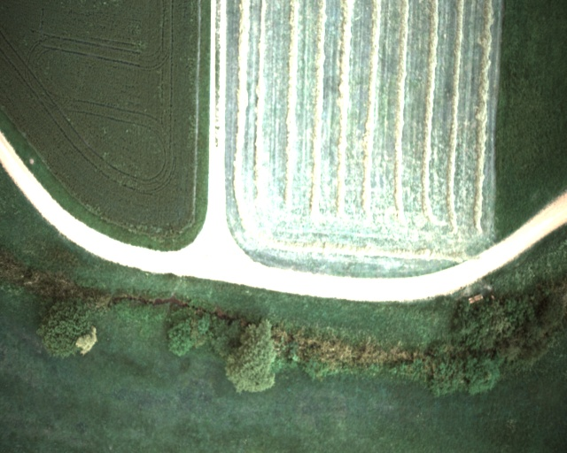
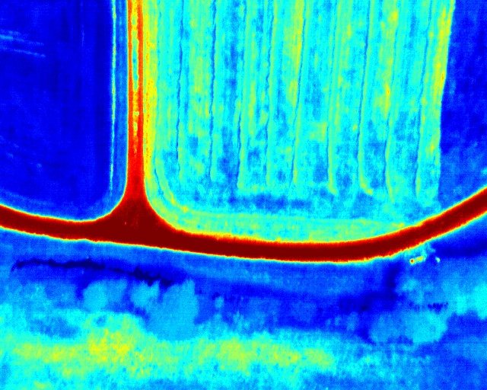
Introduction
Challenges – Example 2
optical
thermal
Gradient inversion

Slide 5
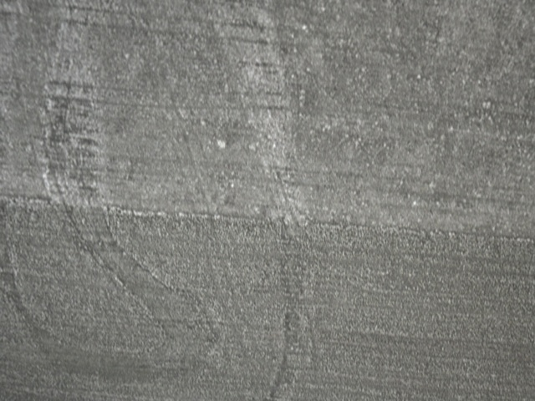
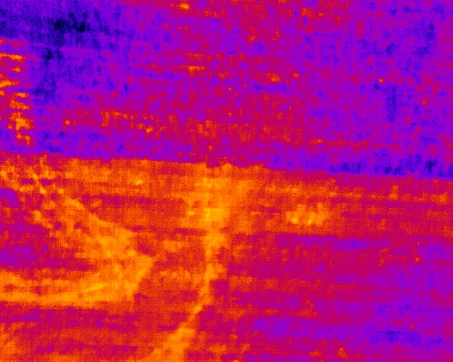
Introduction
Challenges – Example 3
optical
thermal
Non-linear intensity transformation

Slide 6
Introduction
Challenges
Very different task than classical within-modality matching due to:
  Loss of texture
  Gradient inversion
  Non-linear intensity transformations
  Angular dependency of sun reflectance
  Flat-field correction (periodic recalibration of thermal camera)
  Lower resolution of thermal images
No existing methods to match from optical to long-wave infrared images

Slide 7




Introduction
Starting Point
Master thesis ^{[1]} by Bastien Chatton from 2017:
Heatmap generated by rigid forward-projection based only on optical poses
No feedback from thermal images in optimization objective
$$T_{IR}^{ G}=T_{opt}^{ G}⋅T_{IR}^{opt}$$
precalibrated
$$T_{opt}^{ G}$$
$$k$$
$$T_{opt}^{ G}$$
$$k+1$$
IMU
IMU
IMU
Reprojection error
$${ L}_{j}$$
Landmark
[1]: B. Chatton, ”Thermal updraft prediction for a fixed-wing UAV”, Master thesis, ETH Zurich, 2017

Slide 8
Introduction
Starting Point
Heatmap generated using rigid RGB-to-IR transformation ^{[1]}
[1]: B. Chatton, ”Thermal updraft prediction for a fixed-wing UAV”, Master thesis, ETH Zurich, 2017
Notes:
thermal poses not optimized
So where do we start from? Timo, Nicolas, Florian and the rest of the fixed-wing team already have built a pipeline to generate RGB maps. In his Master thesis one and a half years ago, Bastien generate a heatmap following a back-projection approach, only relying on the transformation between the RGB and infrared camera.

Slide 9
Introduction
Project Phases
Phase 1:
Offline ground-truth
data generation
Phase 2:
DNN-based map building
in real-time and onboard
Training
Notes:
Phase 1: computational cost of methods not important, want maximal robustness of method to generate perfectly aligned, cross-spectral image patches
Phase 2: real-time requirement calls for neural network based homography estimation to build aligned optical and thermal maps

Slide 10
Introduction
Project Phases
Phase 1:
Offline ground-truth
data generation
Phase 2:
DNN-based map building
in real-time and onboard
Training
Notes:
Phase 2: real-time requirement calls for neural network based homography estimation to build aligned optical and thermal maps
Phase 1: computational cost of methods not important, want maximal robustness of method to generate perfectly aligned, cross-spectral image patches

Slide 11
Phase 1
Related Work
Offline ground-truth data generation
Keypoint-descriptor based approaches
  Mostly consider optical to near-infrared (far easier than optical to thermal)
  Log-Gabor Histogram Descriptor (LGHD) ^{[2]}
Mutual Information based approaches
  Mutual Information for Lucas-Kanade Tracking (MILK) ^{[3]}
[2]: C. A. Aguilera, A. D. Sappa, R. Toledo, "LGHD: A feature descriptor for matching across non-linear intensity variations", IEEE International Conference on Image Processing (ICIP), 2015
[3]: N. Dowson, R. Bowden, “Mutual Information for Lucas-Kanade Tracking (MILK): An Inverse Compositional Formulation”, IEEE Transactions on Pattern Analysis and Machine Intelligence (TPAMI) 2007
Notes:
Do not explain MI in detail

Slide 12
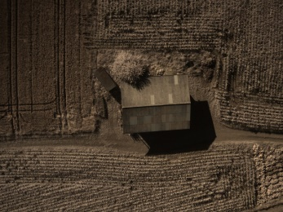








Phase 1 | Cross-spectral Image Alignment
Ground-Truth Data Generation
Cross-spectral Image Alignment: match images taken at $t_{k}$
$$⋮$$
$$⋮$$
$$t_{k}$$
$$t_{k+1}$$
optical
thermal
$$⋮$$
$$⋮$$
Notes:
Explain what we will change and why this requires RGB to IR matching

Slide 13
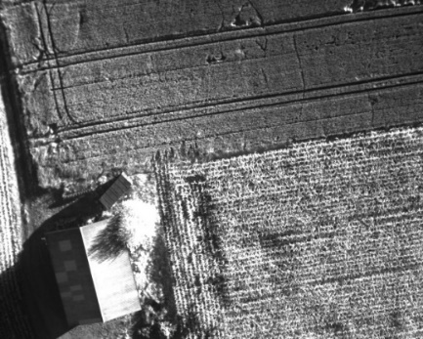
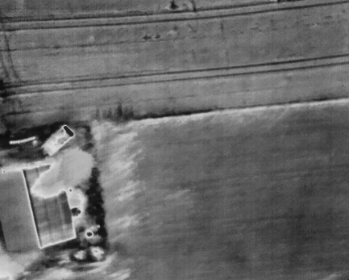
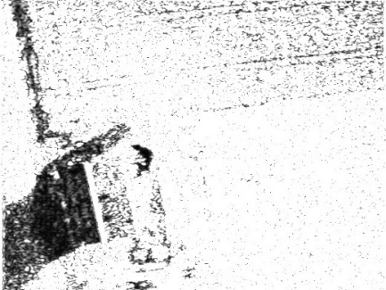
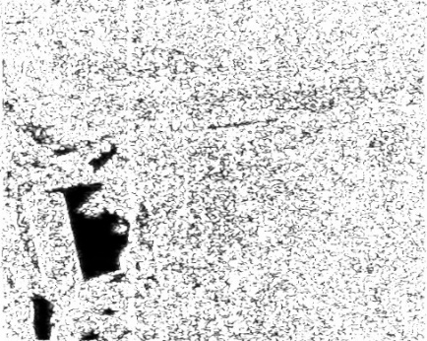
Phase 1 | Cross-spectral Image Alignment
Keypoint Matching based on LGHD
SIFT-like pyramid of Log-Gabor filtered images on 6 scales and 8 orientations
Descriptor stores scale and orientation of maximum response for each pixel
Log-Gabor filtered images in optical (left) and thermal (right) for scale 1, orientation 1
Notes:
In order to robustly build a registered heatmap, we need to match the images taken by the infrared camera to the RGB images. This is a much harder task than normal RGB to RGB matching due to non-linear image distortions and loss of most texture in infrared (see image below).
Most commonly used descriptors are not optimized for such a task and perform quite poorly (e.g. SIFT). Trying to overcome this we implemented a Log-Gabor filter-based Histogram Descriptor. The reason why we decided to use LGHD is that we saw that edges and sharp intensity changes (e.g. human built structures, paths) remain the most similar across optical and infrared spectrum. These are high-frequency image components. LGHD is basically a variation of SIFT that operates on high-pass filtered images. In the filtered space, the cross-spectral images are more similar to each other which makes the recognizing corresponding interest points more feasible.
However, even such descriptors that are optimized for cross-spectral matching cannot provide real-time performance. We can however use them, to generate ground-truth-like data to then train a neural-network based approach.
FAST keypoints and adaptive NMS

Slide 14
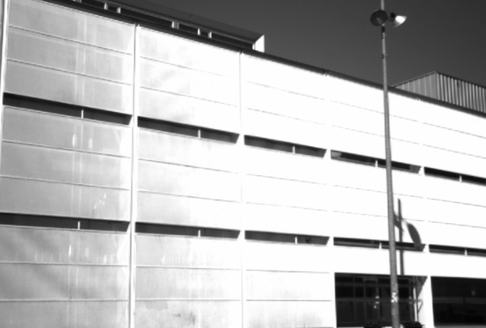
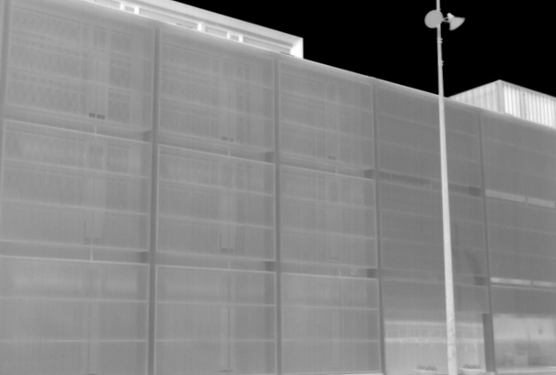
Phase 1 | Cross-spectral Image Alignment
Performance of LGHD compared to SURF
ICIP dataset ^{[2]}
optical
thermal
[2]: C. A. Aguilera, A. D. Sappa, R. Toledo, "LGHD: A feature descriptor for matching across non-linear intensity variations", IEEE International Conference on Image Processing (ICIP), 2015
Notes:
explain datasets (human built, ground based, known transformation)

Slide 15
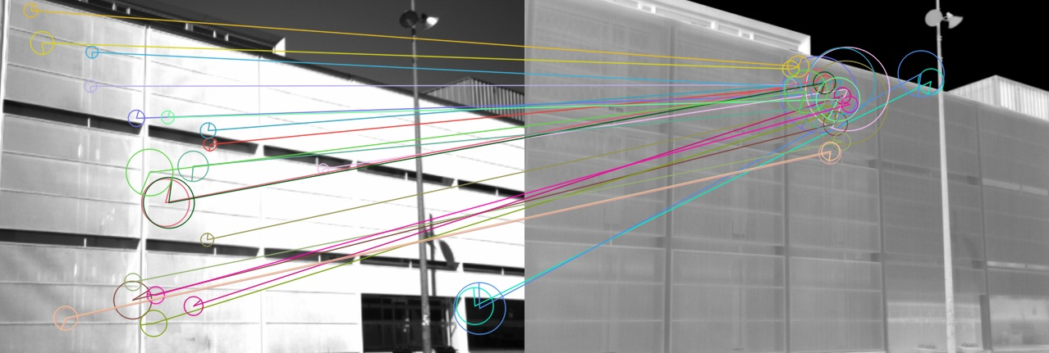
Phase 1 | Cross-spectral Image Alignment
Performance of LGHD compared to SURF
SURF
optical
thermal

Slide 16
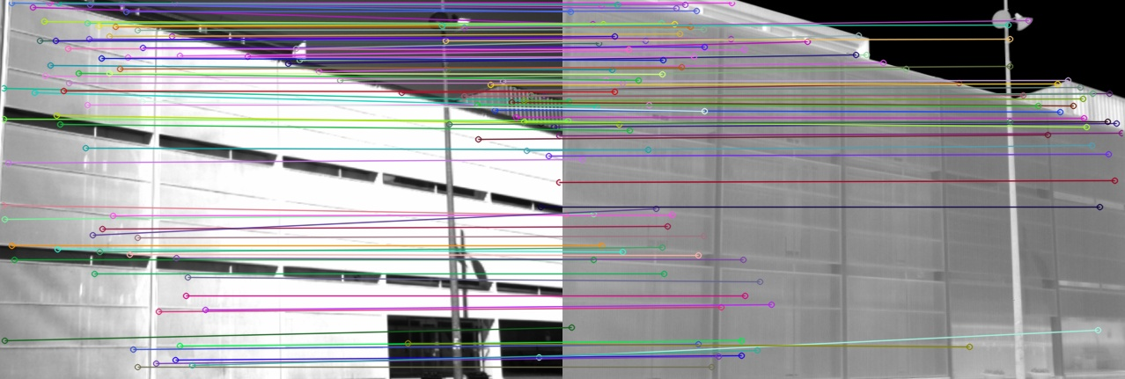
Phase 1 | Cross-spectral Image Alignment
Performance of LGHD compared to SURF
LGHD
optical
thermal

Slide 17
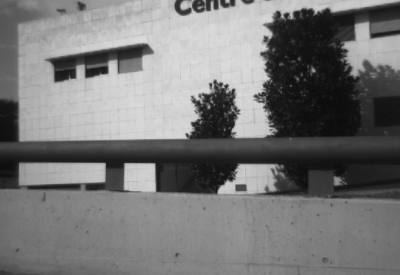
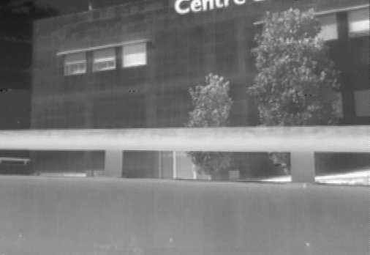
Phase 1 | Cross-spectral Image Alignment
Performance of LGHD compared to SURF
EOH dataset ^{[4]}
optical
thermal
[4]: C. A. Aguilera, F. Barrera, F. Lumbreras, A. D Sappa, R. Toledo, “Cross-spectral Image Feature Points”, Sensors, 2012

Slide 18
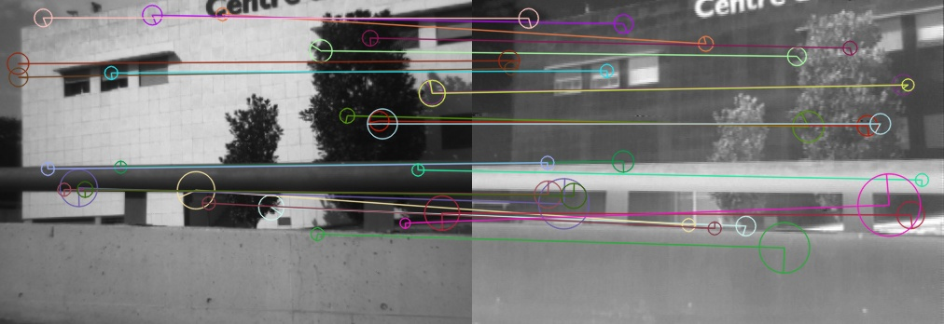
Phase 1 | Cross-spectral Image Alignment
Performance of LGHD compared to SURF
SURF
optical
thermal

Slide 19
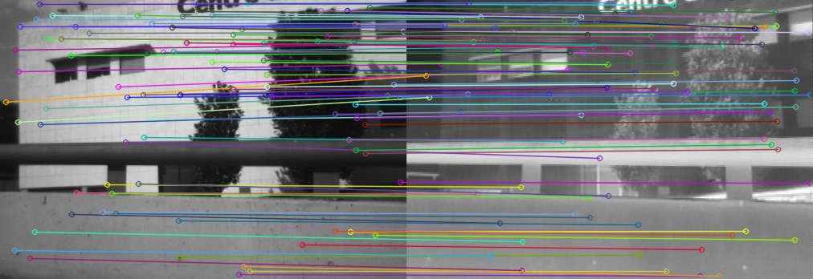
Phase 1 | Cross-spectral Image Alignment
Performance of LGHD compared to SURF
LGHD
optical
thermal

Slide 20
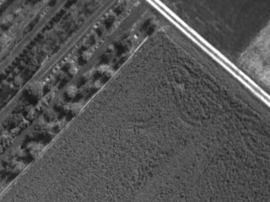
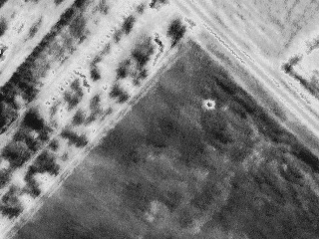
Phase 1 | Cross-spectral Image Alignment
Performance of LGHD compared to SURF
WARM (UAV imagery)
optical
thermal

Slide 21
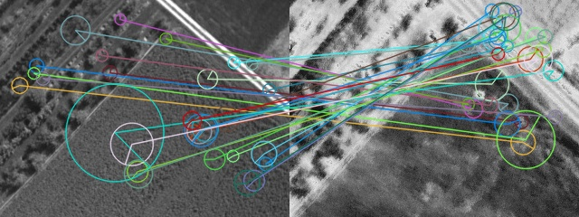
Phase 1 | Cross-spectral Image Alignment
Performance of LGHD compared to SURF
SURF
optical
thermal

Slide 22
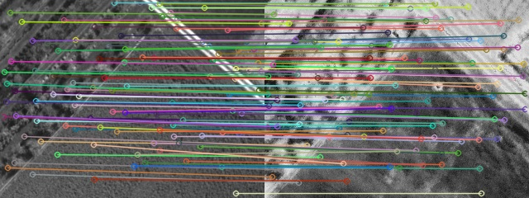
Phase 1 | Cross-spectral Image Alignment
Performance of LGHD compared to SURF
LGHD
optical
thermal

Slide 23
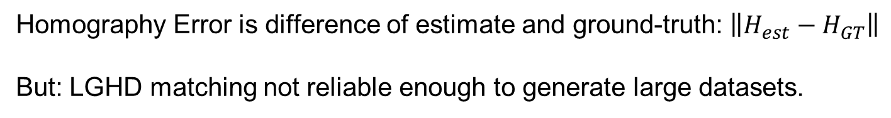
Phase 1 | Cross-spectral Image Alignment
Performance of LGHD compared to SURF
Method | Dataset | Homography Error
SURF | ICIP ^{[2]} | 211.7
LGHD | ICIP ^{[2]} | 8.6
SURF | EOH ^{[4]} | 180.0
LGHD | EOH ^{[4]} | 21.7
SURF | WARM | 146.9*
LGHD | WARM | 16.0*
Results for homography estimation with LGHD and SURF
Homography Error is difference of estimate and ground-truth: $\left\|H_{est}−H_{GT}\right\|$
But: LGHD matching not reliable enough to generate large datasets.
Methods used with tuned RANSAC and LMEDS parameters.
[2]: C. A. Aguilera, A. D. Sappa, R. Toledo, "LGHD: A feature descriptor for matching across non-linear intensity variations", IEEE International Conference on Image Processing (ICIP), 2015
[4]: C. A. Aguilera, F. Barrera, F. Lumbreras, A. D Sappa, R. Toledo, “Cross-spectral Image Feature Points”, Sensors, 2012
Notes:
No ground truth available for UAV
Manual post-processing needed and too few perfect matches!

Slide 24
Phase 1 | Pose Graph Optimization
Ground-Truth Data Generation
Pose Graph Optimization: Align images globally
  Pix4Dmapper
  Landmark triangulation using SURF and LGHD
$$⋮$$
$$⋮$$
$$t_{k}$$
$$t_{k+1}$$
optical
thermal
$$⋮$$
$$⋮$$
Notes:
Explain what we will change and why this requires RGB to IR matching

Slide 25




Phase 1 | Pose Graph Optimization
Ground-Truth Data Generation
Pose Graph Optimization: Align images globally
  Pix4Dmapper
  Landmark triangulation using SURF and LGHD
  Goal: robustness to compensate for shutter delay and uncertainties
$$T_{opt}^{ G}$$
$$k$$
$$T_{IR}^{ G}$$
$$k$$
$$T_{opt}^{ G}$$
$$k+1$$
IMU
IMU
IMU
IMU
Reprojection error
$${ L}_{j}$$
Landmark
Notes:
Explain what we will change and why this requires RGB to IR matching
Also allows for thermal camera calibration on the go
Leads to globally more consistent heatmap

Slide 26
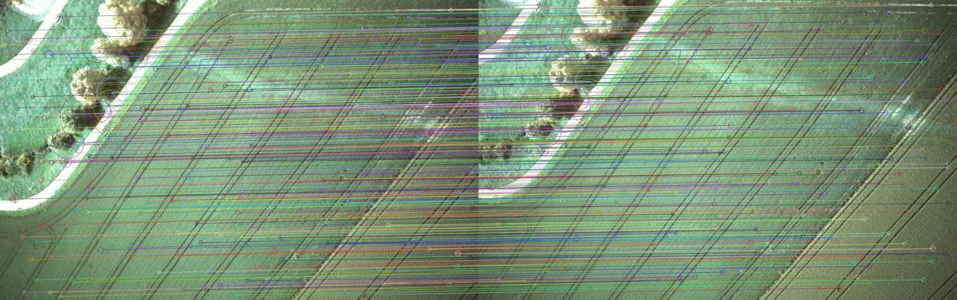
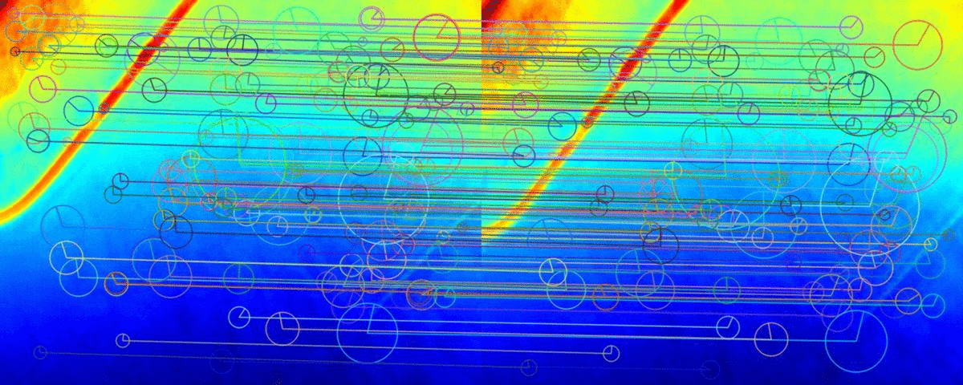
Phase 1 | Pose Graph Optimization
Landmark Triangulation using SURF and LGHD
Step 1: Sequential within-modality SURF matches to get feature tracks

Slide 27
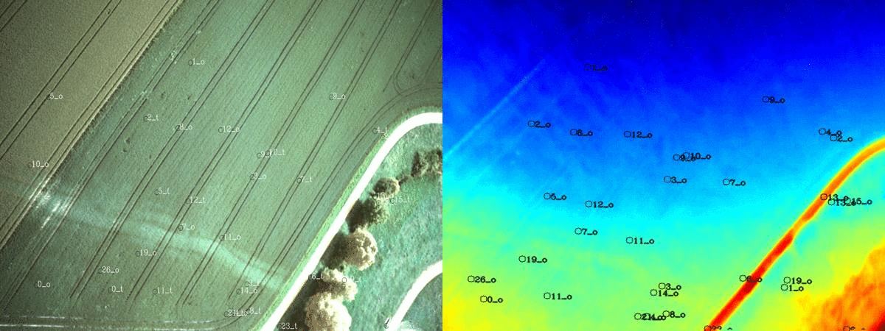
Phase 1 | Pose Graph Optimization
Landmark Triangulation using SURF and LGHD
Step 2: Triangulate 3D landmarks from tracks and optimize with GTSAM

Slide 28
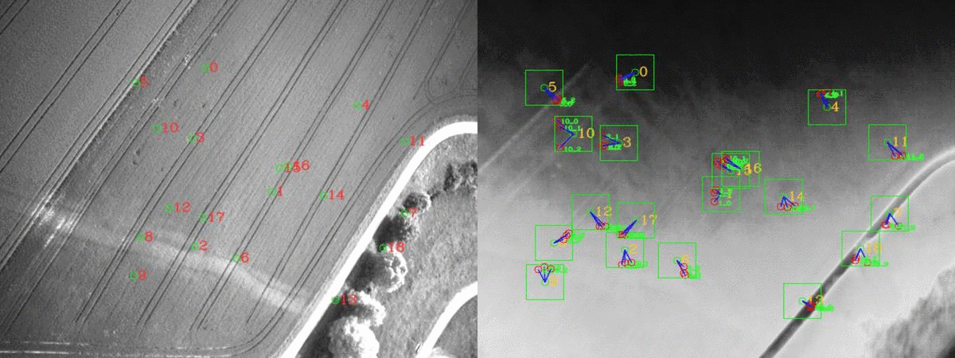
Phase 1 | Pose Graph Optimization
Landmark Triangulation using SURF and LGHD
Step 3: Rectify reprojection errors by matching landmarks across spectra

Slide 29
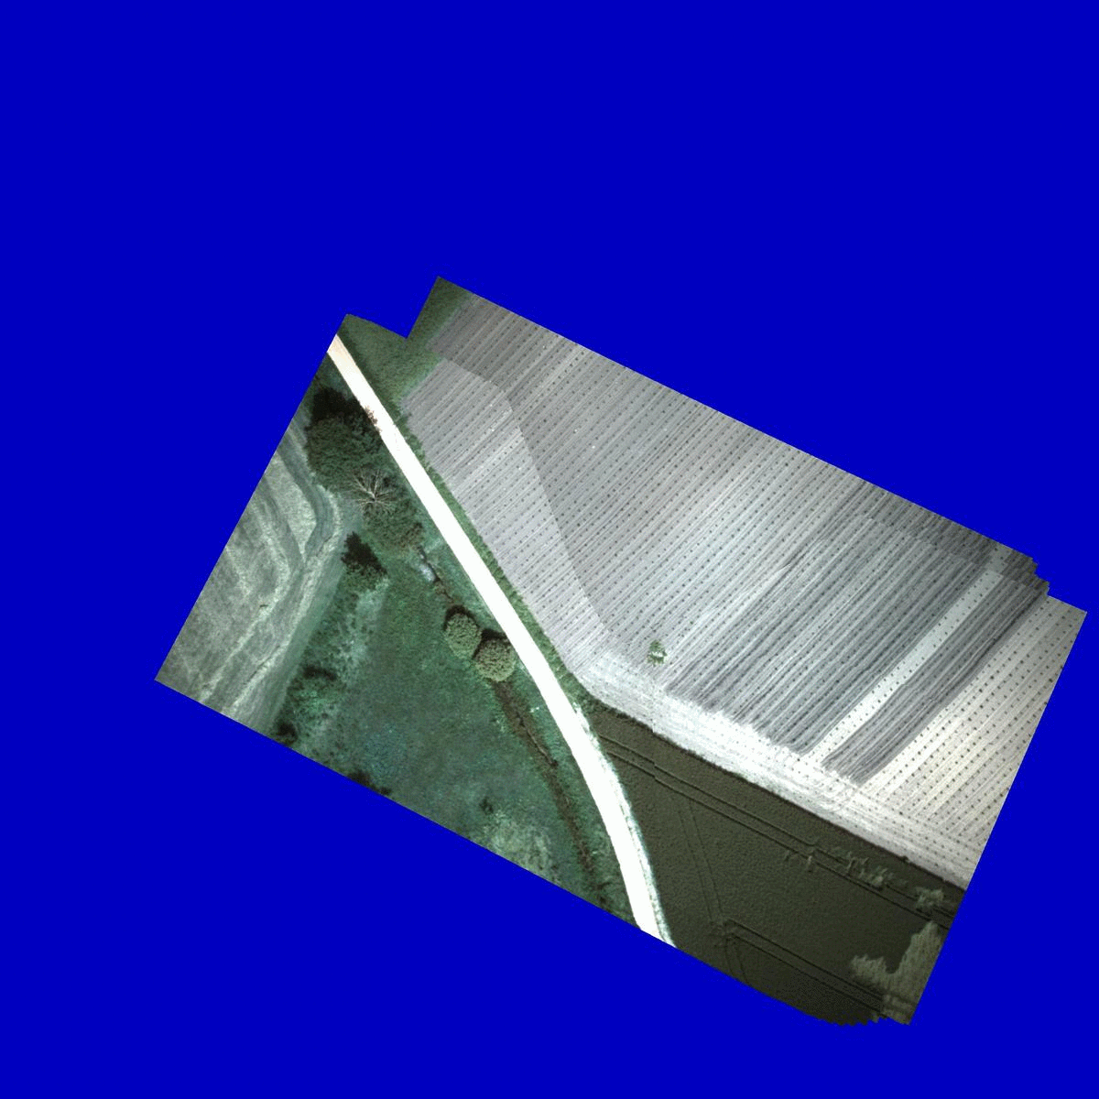
Phase 1 | Pose Graph Optimization
Landmark Triangulation using SURF and LGHD
Generated aligned orthomosaics for both spectra (preliminary)

Slide 30
Phase 1
Conclusion and Future Work
Implemented and tested 3 methods to generate ground-truth
Remaining steps until report deadline:
Data augmentation on registered maps (rendering)
Apply Pix4Dmapper to newest data recorded (higher overlap)
Long-term improvements:
Cross-spectral matching based on Mutual Information
Notes:
Pix4D Mapper: Optimizations for cross-spectral camera rigs planned

Slide 31
Phase 1
Generated Ground-Truth and other Datasets
WARM (UAV imagery)
~1‘000 samples
Notes:
Before going forward to the neural network training, we will include LGHD into the existing pipeline and use it to register the infrared images to an optical map one by one. We then extract patch correspondences from these maps as training data by rendering registered maps from different positions (scale and orientation)
Using these patches we will then train two separate networks, one for detecting interest points and one for building descriptors for them. Normally, feature detection is computationally simple and does not require learning based approaches. For cross-spectral detection however, we need to learn what points are similar across-spectra, which normal interest point detectors cannot.
Finally, we hope to be able to generate registered heatmaps onboard the drone in real-time. Remaining issues with infrared camera: only get relative temperature measurements and flat-field correction

Slide 32
Phase 1
Generated Ground-Truth and other Datasets
ICIP ^{[2]} & EOH ^{[4]}
~300 samples
[2]: C. A. Aguilera, A. D. Sappa, R. Toledo, "LGHD: A feature descriptor for matching across non-linear intensity variations", IEEE International Conference on Image Processing (ICIP), 2015
[4]: C. A. Aguilera, F. Barrera, F. Lumbreras, A. D Sappa, R. Toledo, “Cross-spectral Image Feature Points”, Sensors, 2012
Notes:
Before going forward to the neural network training, we will include LGHD into the existing pipeline and use it to register the infrared images to an optical map one by one. We then extract patch correspondences from these maps as training data by rendering registered maps from different positions (scale and orientation)
Using these patches we will then train two separate networks, one for detecting interest points and one for building descriptors for them. Normally, feature detection is computationally simple and does not require learning based approaches. For cross-spectral detection however, we need to learn what points are similar across-spectra, which normal interest point detectors cannot.
Finally, we hope to be able to generate registered heatmaps onboard the drone in real-time. Remaining issues with infrared camera: only get relative temperature measurements and flat-field correction

Slide 33
Phase 1
Generated Ground-Truth and other Datasets
ICIP ^{[2]} & EOH ^{[4]}
~300 samples
[2]: C. A. Aguilera, A. D. Sappa, R. Toledo, "LGHD: A feature descriptor for matching across non-linear intensity variations", IEEE International Conference on Image Processing (ICIP), 2015
[4]: C. A. Aguilera, F. Barrera, F. Lumbreras, A. D Sappa, R. Toledo, “Cross-spectral Image Feature Points”, Sensors, 2012
Notes:
Before going forward to the neural network training, we will include LGHD into the existing pipeline and use it to register the infrared images to an optical map one by one. We then extract patch correspondences from these maps as training data by rendering registered maps from different positions (scale and orientation)
Using these patches we will then train two separate networks, one for detecting interest points and one for building descriptors for them. Normally, feature detection is computationally simple and does not require learning based approaches. For cross-spectral detection however, we need to learn what points are similar across-spectra, which normal interest point detectors cannot.
Finally, we hope to be able to generate registered heatmaps onboard the drone in real-time. Remaining issues with infrared camera: only get relative temperature measurements and flat-field correction

Slide 34
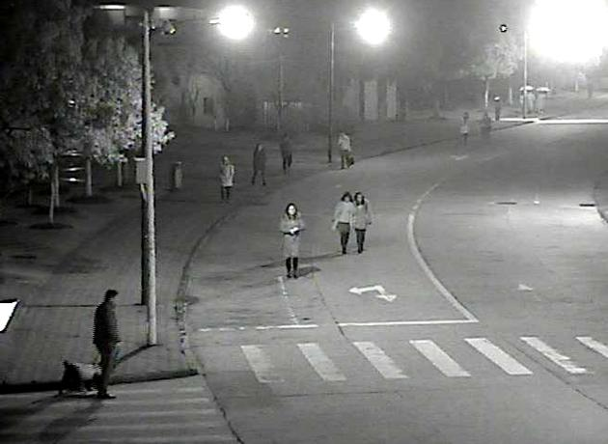
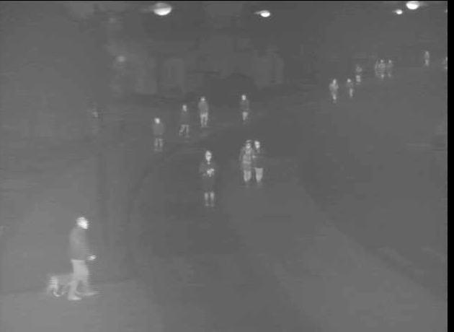
Phase 1
Generated Ground-Truth and other Datasets
VOT-RGBTIR ^{[5]}
~1’000 samples
[5]: Dataset provided by VOT2019 Challenge, part of ICCV 2019 and sponsored by the University of Ljubljana
Notes:
Before going forward to the neural network training, we will include LGHD into the existing pipeline and use it to register the infrared images to an optical map one by one. We then extract patch correspondences from these maps as training data by rendering registered maps from different positions (scale and orientation)
Using these patches we will then train two separate networks, one for detecting interest points and one for building descriptors for them. Normally, feature detection is computationally simple and does not require learning based approaches. For cross-spectral detection however, we need to learn what points are similar across-spectra, which normal interest point detectors cannot.
Finally, we hope to be able to generate registered heatmaps onboard the drone in real-time. Remaining issues with infrared camera: only get relative temperature measurements and flat-field correction

Slide 35
Project Phases
Phase 1:
Offline ground-truth
data generation
Phase 2:
DNN-based map building
in real-time and onboard
Training

Slide 36
Phase 2
Related Work
DNN-based map building in real-time and onboard
Detectors:
  Quad-networks: unsupervised learning to rank for interest point detection ^{[6]}
Descriptors:
  Q-net: Cross-Spectral Local Descriptors via Quadruplet Network ^{[7]}
  HybridCNN: Multimodal matching using a Hybrid Convolutional Neural Network ^{[8]}
End-to-end homography estimation:
  SuperPoint: Self-Supervised Interest Point Detection and Description ^{[9]}
[6]: N. Savinov, A. Seki, L. Ladicky, T. Sattler, M. Pollefys, “Quad-networks: unsupervised learning to rank for interest point detection”, CVPR 2017
[7]: C. A. Aguilera-Carrasco, A. D. Sappa, R.Toledo, “Cross-Spectral Local Descriptors via Quadruplet Network”, Sensors 2017
[8]: E. B. Baruch, Y. Keller , ”Multimodal matching using a Hybrid Convolutional Neural Network”, CoRR 2018
[9]: D. DeTone,T. Malisiewicz, A. Rabinovich, “SuperPoint: Self-Supervised Interest Point Detection and Description”, CoRR, 2017
Notes:
Both keypoint detection and description are to be optimized across spectra
Mention trend towards multiple encoders
Quad-networks: Detector only, shown to work well on RGB to depth, which is similar task, no open-source code
Q-net: Quadruple architecture, Four encoders (two for each spectrum), with all weights shared, only tested on NIR, but same group has shown transfer learning to LWIR in a previous work but using a much heavier quadruple network, code available
HybridCNN: uses Siamese CNN and a dual non-weight-sharing CNNs, hence also quadruple. Very good results through hard-negative mining and special auxiliary loss. Tested on NIR only, Code available
All only show convincing results on optical to thermal yet
SuperPoint allows end-to-end training and one joint model with real-time performance

Slide 37
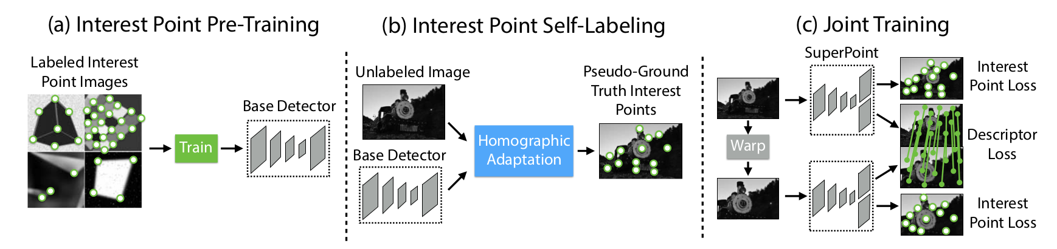
Phase 2 | Related Work
SuperPoint
Fully convolutional, single encoder network trained in self-supervised manner using Homographic Adaption on MS-COCO (~80’000 high resolution images)
We use an open-source TensorFlow implementation of SuperPoint ^{[10]}
[9]: D. DeTone,T. Malisiewicz, A. Rabinovich, “SuperPoint: Self-Supervised Interest Point Detection and Description”, CoRR, 2017
Figure explaining training procedure taken from [9]
[10]: R. Pautrat and P.-E. Sarlin, ETH Zurich, 2018, code repository: https://github.com/rpautrat/SuperPoint

Slide 38
Phase 2 | SuperPoint
Change Training for cross-spectral SuperPoint
Pre-training of Base Detector:
Use synthetic images rendered from geometry shapes like in vanilla version
[9]: D. DeTone,T. Malisiewicz, A. Rabinovich, “SuperPoint: Self-Supervised Interest Point Detection and Description”, CoRR, 2017
Figure explaining training procedure taken from [9]

Slide 39
Phase 2 | SuperPoint
Change Training for cross-spectral SuperPoint
Interest Point Self-Labeling and Joint Training:
Go from optical to warped thermal image instead of warped optical image
Use standard learning parameters (learning rates, detection thresholds)
Add thermal images
Figure explaining training procedure taken from [9]

Slide 40
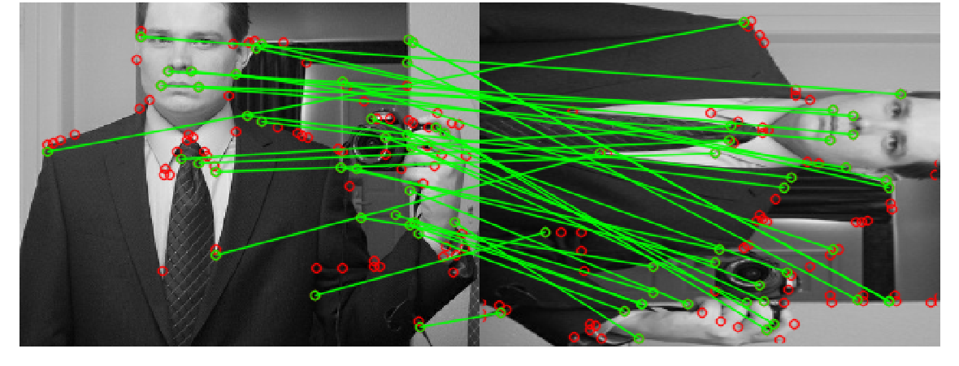
Phase 2 | SuperPoint
Experiments
Experiment 1a: Sanity-check changes made to pipeline
Fool network by providing optical image as thermal input
Train on MS-COCO, test on MS-COCO: 60.4% homography correctness *
* Homography correctness defined as percentage of correctly estimated warps up to a certain threshold

Slide 41
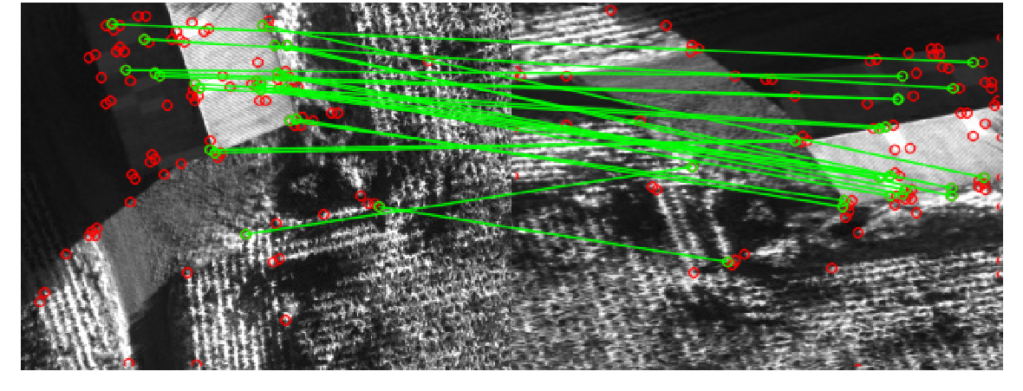
Phase 2 | SuperPoint
Experiments
Experiment 1b: Sanity-check changes made to pipeline
Fool network by providing optical image as thermal input
Train on MS-COCO, test on UAV imagery: 21.5% homography correctness
Data completely unseen during training, hence large performance drop

Slide 42
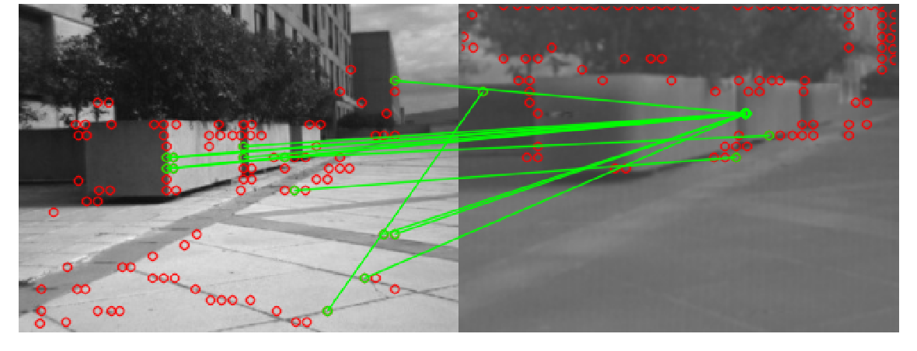
Phase 2 | SuperPoint
Experiments
Experiment 2: Train on cross-spectral data only
Train on all cross-spectral data, test on cross-spectral data
Cannot learn reliable cross-spectral descriptors

Slide 43
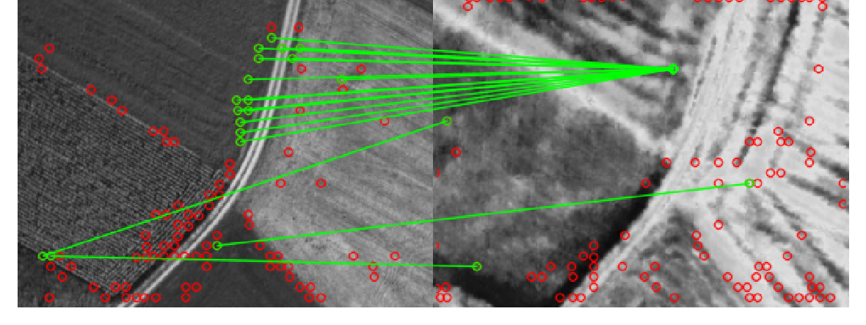
Phase 2 | SuperPoint
Experiments
Experiment 2: Train on cross-spectral data only
Train on all cross-spectral data, test on cross-spectral data
Cannot learn reliable cross-spectral descriptors

Slide 44
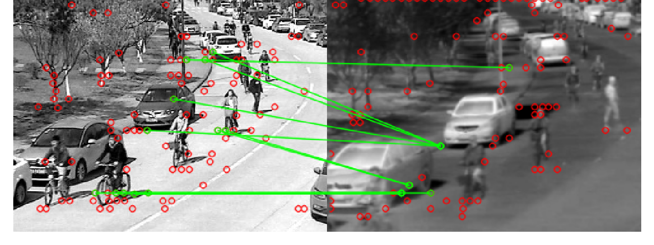
Phase 2 | SuperPoint
Experiments
Experiment 2: Train on cross-spectral data only
Train on all cross-spectral data, test on cross-spectral data
Cannot learn reliable cross-spectral descriptors

Slide 45
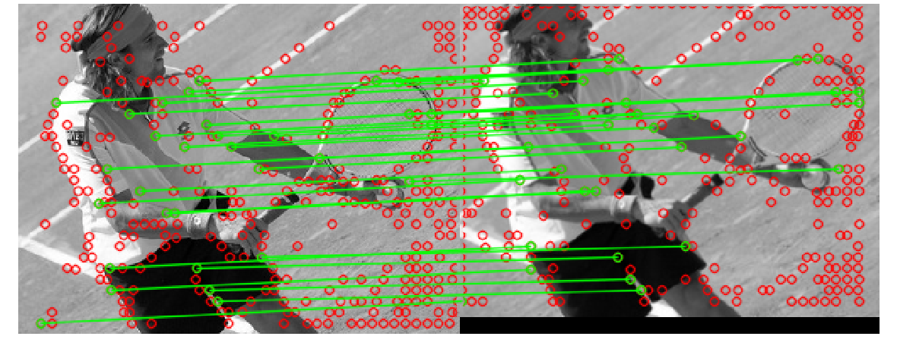
Phase 2 | SuperPoint
Experiments
Experiment 3: Train on both optical and cross-spectral data (balanced)
Train on MS-COCO and all cross-spectral data, test on cross-spectral data
Successful learning for optical to optical

Slide 46
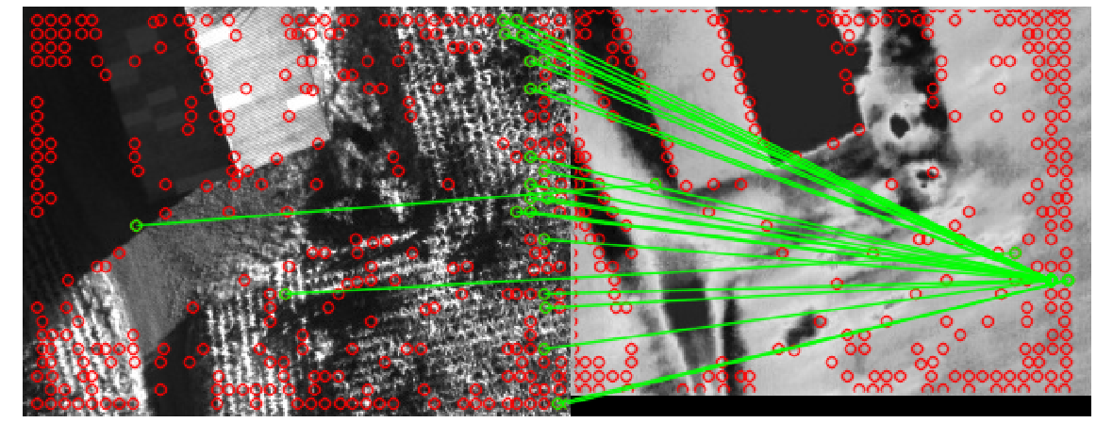
Phase 2 | SuperPoint
Experiments
Experiment 3: Train on both optical and cross-spectral data (balanced)
Train on MS-COCO and all cross-spectral data, test on cross-spectral data
Cannot learn reliable cross-spectral descriptors

Slide 47
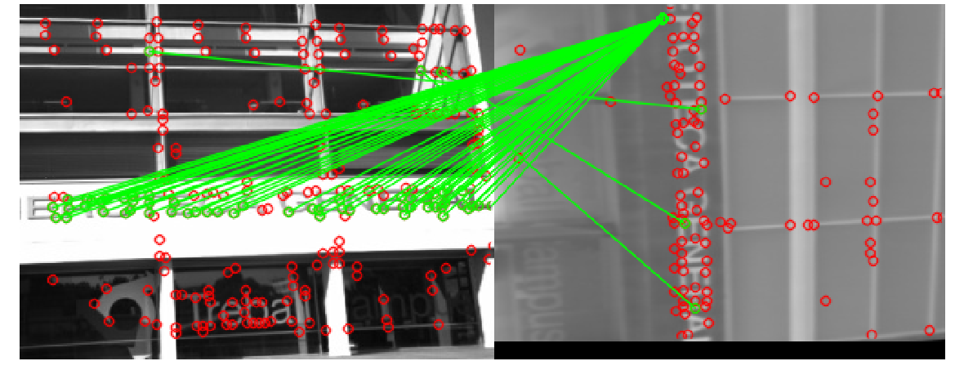
Phase 2 | SuperPoint
Experiments
Experiment 4a: Test if network can capture cross-spectral transformation
Train and test on single image pair from ICIP
Not successful for strong warped image pair

Slide 48
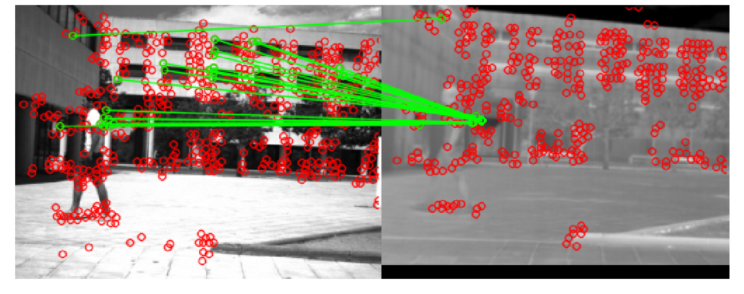
Phase 2 | SuperPoint
Experiments
Experiment 4a: Test if network can capture cross-spectral transformation
Train and test on single image pair from ICIP
Not successful for slightly warped image pair either

Slide 49
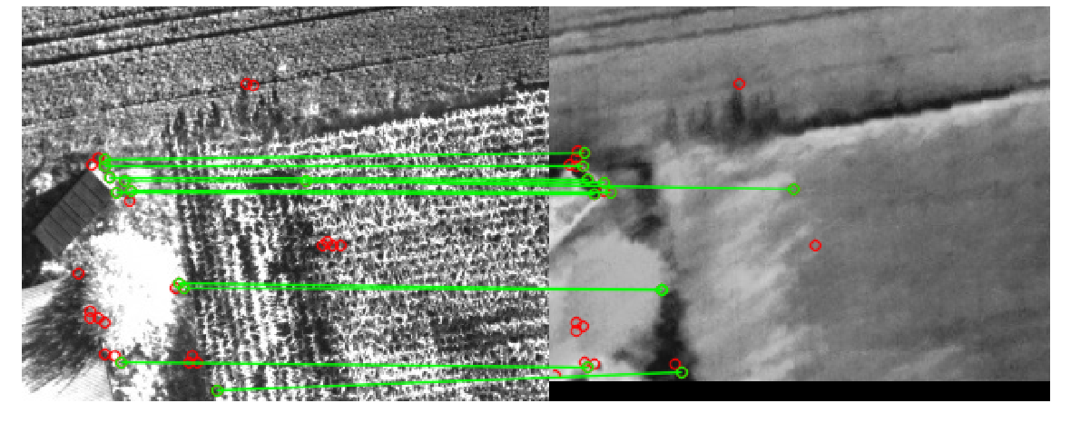
Phase 2 | SuperPoint
Experiments
Experiment 4b: Test if network can capture cross-spectral transformation
Train and test on single image pair from WARM
Can learn cross-spectral descriptors for very small warps of thermal image

Slide 50
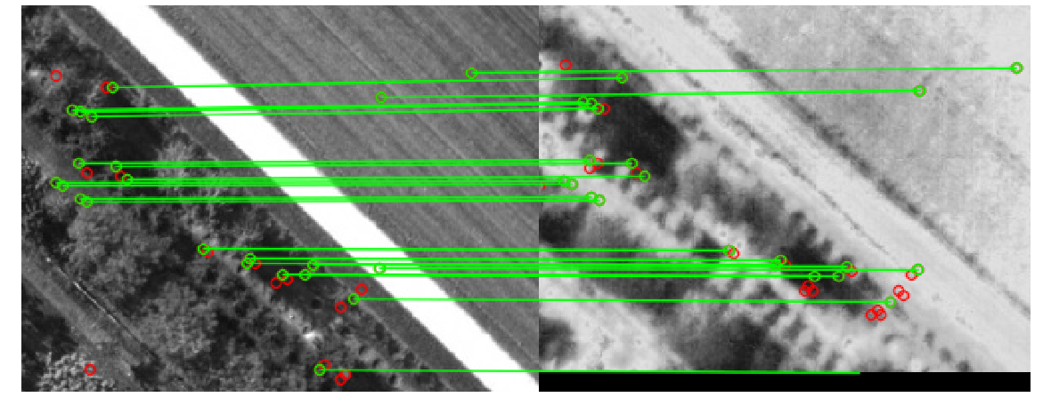
Phase 2 | SuperPoint
Experiments
Experiment 4b: Test if network can capture cross-spectral transformation
Train and test on single image pair from WARM
Can learn cross-spectral descriptors for very small warps of thermal image

Slide 51
Phase 2 | SuperPoint
Conclusions and Future Work
Preliminary findings:
SuperPoint is expressive enough to learn cross-spectral descriptors
Not yet able to teach generalizable cross-spectral matching
Remaining steps until report deadline:
Train again with augmented WARM dataset, lower detection threshold, regularization and higher batch size
Better understand inability to overfit network to images from ICIP and tendency to have many-to-one matches

Slide 52

Phase 2 | SuperPoint
Conclusions and Future Work
Long-term improvements:
Improve initialization of Base Detector
→ Add non-linear intensity changes to synthetic shapes to mimic domain gap
Separate characteristics of both modalities to prevent “confusion”
→ Use one encoder per modality, like quadruple network seen in other works
Figure explaining training procedure taken from [9]

Slide 53
Any questions?

Slide 54

Phase 1 | Related work
RGB-T SLAM
Backup
Cross-spectral part fully feed-forward
Only considers within-modality matches (no cross-spectral image alignment)
No added robustness through error feedback
No possibility to improve intrinsic and extrinsic calibration errors
Cannot correct for different shutter times

Slide 55

Phase 1 | Cross-spectral Image Alignment
Keypoint Matching based on LGHD
Backup
Focus on characteristics that are invariant to cross-spectral transformation by building descriptor on high-pass filtered images
Added keypoint detection in filtered image space
Log-Gabor filters: localize spatial and frequency information jointly
$G\left(f\right)=\exp\left(\frac{−{\left(\log\left(f/{f_{0}}\right)\right)}^{2}}{{2\left(\log\left(σ/{f_{0}}\right)\right)}^{2}}\right)$
Implemented in C++ based on open-source MATLAB code^{[2]} and external phase congruency library for C++ ^{[4]} achieving a speed up of factor ~3.5x
Timing MATLAB (4 scales, 6 orientations, 4’000 keypoints): 70.05s / image
Timing C++ (6 scales, 8 orientations, 4’000 keypoints): 21.59 s / image
Could further speed up by using multi-threading FFTW library
[4]: https://github.com/chvillap/phase-congruency-features
Notes:
In order to robustly build a registered heatmap, we need to match the images taken by the infrared camera to the RGB images. This is a much harder task than normal RGB to RGB matching due to non-linear image distortions and loss of most texture in infrared (see image below).
Most commonly used descriptors are not optimized for such a task and perform quite poorly (e.g. SIFT). Trying to overcome this we implemented a Log-Gabor filter-based Histogram Descriptor. The reason why we decided to use LGHD is that we saw that edges and sharp intensity changes (e.g. human built structures, paths) remain the most similar across optical and infrared spectrum. These are high-frequency image components. LGHD is basically a variation of SIFT that operates on high-pass filtered images. In the filtered space, the cross-spectral images are more similar to each other which makes the recognizing corresponding interest points more feasible.
However, even such descriptors that are optimized for cross-spectral matching cannot provide real-time performance. We can however use them, to generate ground-truth-like data to then train a neural-network based approach.

Slide 56

Phase 1 | Cross-spectral Image Alignment
Keypoint Matching based on LGHD
Backup
Inlier correspondences when performing cross-spectral matching with FAST keypoints and LGHD

Slide 57

Phase 1 | Cross-spectral Image Alignment
Keypoint Matching based on LGHD
Backup
Overlay of RGB image (grey) and warped infrared image (pink)

Slide 58

Phase 1 | Cross-spectral Image Alignment
Performance of LGHD
Backup
LGHD fails to match exactly
optical
thermal

Slide 59


Phase 1 | Cross-spectral Image Alignment
Performance of LGHD
Backup
LGHD fails to match exactly
Overlay of RGB image (grey) and
warped infrared image (color)
Overlaying area cropped out
on optical and thermal image

Slide 60

Phase 1 | Cross-spectral Image Alignment
Keypoint Matching based on LGHD
Backup
LGHD often fails to match exactly

Slide 61

Phase 1 | Cross-spectral Image Alignment
Keypoint Matching based on LGHD
Backup
LGHD often fails to match exactly
Overlay of RGB image (grey) and warped infrared image (color)

Slide 62




Phase 1 | Cross-spectral Image Alignment
Sliding window matching based on MI
Backup
MI surface when sliding patch across image strongly non-convex
Query patch IR
Corresponding patch Optical
Maximum MI
patch Optical

Slide 63




Phase 1 | Cross-spectral Image Alignment
Sliding window matching based on MI
Backup
MI surface when sliding patch across image strongly non-convex
Query patch IR
Corresponding patch Optical
Maximum MI
patch Optical

Slide 64


Phase 1 | Cross-spectral Image Alignment
Optical vs NIR
Backup
Optical Color
Optical Grayscale
Near-infrared

Slide 65


Phase 1 | Cross-spectral Image Alignment
Optical vs LWIR
Backup
Optical Color
Optical Grayscale
Far-infrared

Slide 66


Phase 1 | Pose Graph Optimization
Pix4Dmapper
Backup
Backup
Processing optical and thermal data in separately gives consistent maps
But after merging, no global optimum can be found
Optical only map
Thermal only map
Notes:
Pix4d optimize many small, separated regions
Shows how hard cross-spectral matching is
overlap too small

Slide 67
Phase 1
Generated Ground-Truth and other Datasets
Backup
Backup
WARM (UAV imagery)
  Aerial images from glider
  Aligned with LGHD (no Pose Graph Optimization, manually filtered)
  ~1’000 samples
ICIP ^{[2]} & EOH ^{[5]}
  Pre-aligned handheld images of mostly human-built structures
  ~1’000 samples
VOT-RGBTIR ^{[6]}
  Pre-aligned security camera footage of outdoor scenes
  ~100’000 samples
  Low-quality images and highly repetitive
[2]: C. A. Aguilera, A. D. Sappa, R. Toledo, "LGHD: A feature descriptor for matching across non-linear intensity variations", IEEE International Conference on Image Processing (ICIP), 2015
[5]: C. A. Aguilera, F. Barrera, F. Lumbreras, A. D Sappa, R. Toledo, “Cross-spectral Image Feature Points”, Sensors, 2012
[6]: Dataset provided by VOT2019 Challenge, part of ICCV 2019 and sponsored by the University of Ljubljana
Notes:
Before going forward to the neural network training, we will include LGHD into the existing pipeline and use it to register the infrared images to an optical map one by one. We then extract patch correspondences from these maps as training data by rendering registered maps from different positions (scale and orientation)
Using these patches we will then train two separate networks, one for detecting interest points and one for building descriptors for them. Normally, feature detection is computationally simple and does not require learning based approaches. For cross-spectral detection however, we need to learn what points are similar across-spectra, which normal interest point detectors cannot.
Finally, we hope to be able to generate registered heatmaps onboard the drone in real-time. Remaining issues with infrared camera: only get relative temperature measurements and flat-field correction

Slide 68


Phase 2
Neural Networks for Cross-Spectral Matching
Backup
Cross-spectral match
IR
IR
DNN
Feature
descriptors
Optical
Optical
Landmark
Matches
Notes:
Sample patch correspondences from registered optical and thermal maps as training data

Slide 69

Phase 2 | SuperPoint
Experiments
Backup
Experiment 4a: Train only on one cross-spectral pair from ICIP
Train and test on single image pair from ICIP
Evaluate if network can capture cross-spectral transformation
Learns cross-spectral descriptors, but only match if thermal image not warped

Slide 70

Phase 2 | SuperPoint
Experiments
Backup
Experiment 4a: Train only on one cross-spectral pair from ICIP
Train and test on single image pair from ICIP
Evaluate if network can capture cross-spectral transformation
Learns cross-spectral descriptors, but only match if thermal image not warped

