Slide 1

Multimodal Feedback Control for Aerial Manipulation
Master Thesis – Final Talk
Felix Graule
Supervised by Prof. Dr. Margarita Chli & Dr. Stefan Leutenegger

Slide 2
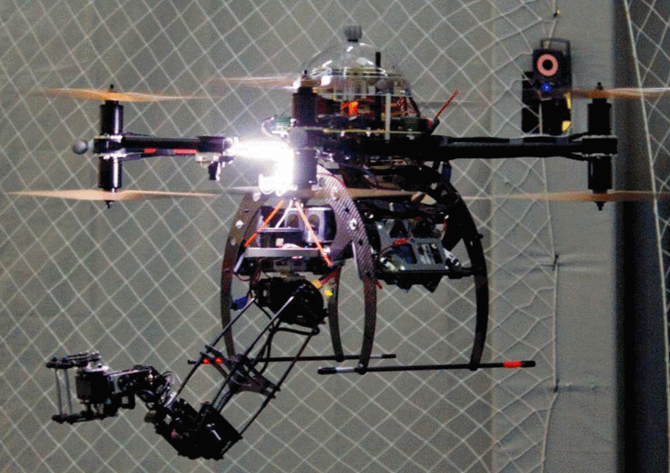
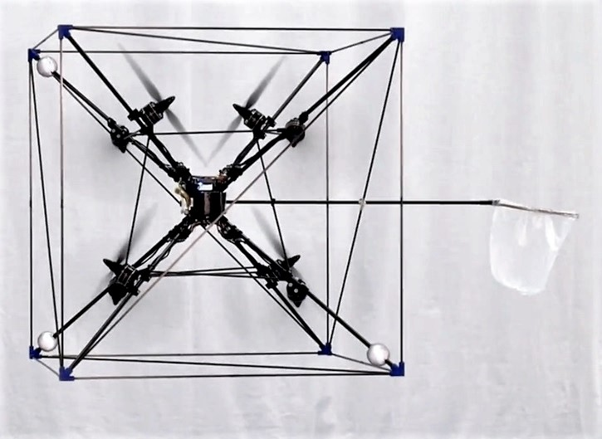
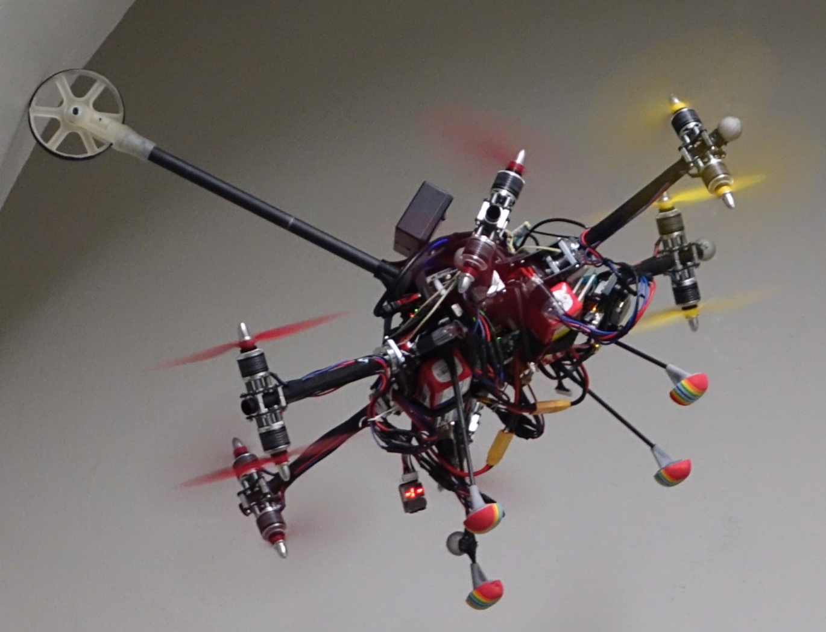
Introduction:
Aerial Manipulation Tasks
Grasping
Fetching
Pushing
F. Ruggiero et al., "A multilayer control for multirotor UAVs equipped with a servo robot arm," ICRA 2015
D. Brescianini et al., "Design, modeling and control of an omni-directional aerial vehicle," ICRA 2016
K. Bodie et al. “An Omnidirectional Aerial Manipulation Platform for Contact-Based Inspection.” ArXiv 2019

Slide 3
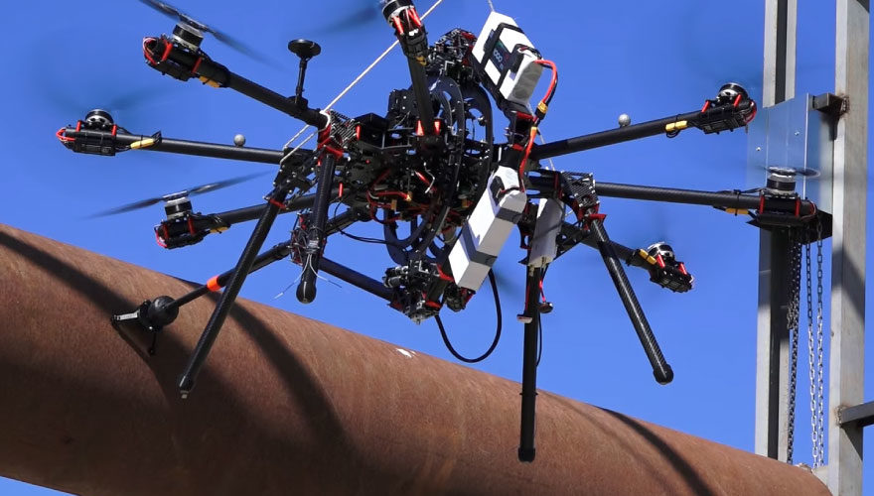
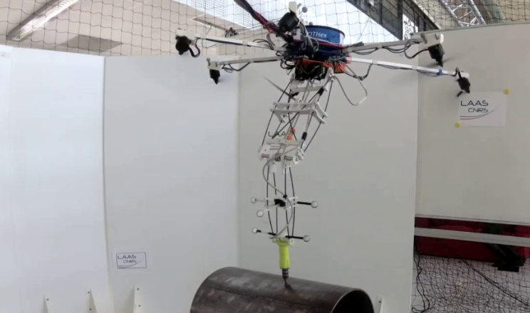
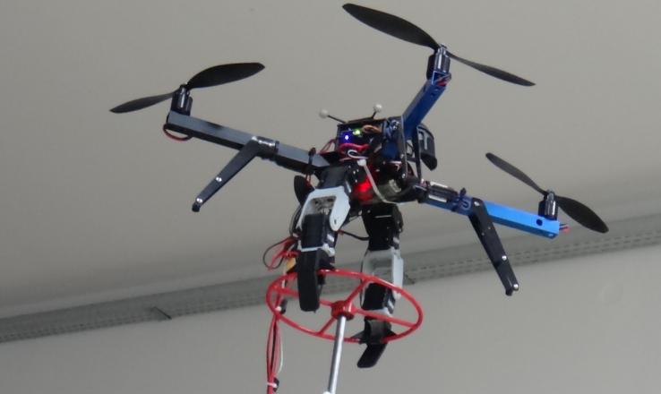
Introduction:
Aerial Manipulation Applications
Inspection
Maintenance
Remote Interaction
Trujillo et al., “Novel Aerial Manipulator for Accurate and Robust Industrial NDT Contact Inspection: A New Tool for the Oil and Gas Inspection Industry”, Sensors 2019
M. Tognon et al., "A Truly-Redundant Aerial Manipulator System With Application to Push-and-Slide Inspection in Industrial Plants” RAL 2019
C. Korpela et al., “Towards valve turning using a dual-arm aerial manipulator”, IROS 2014

Slide 4



Introduction:
Research Gap
Recent advances focus on fully-actuated MAVs
Under-actuated MAVs cheap and widespread
Plug-and-play End Effector extension

Slide 5
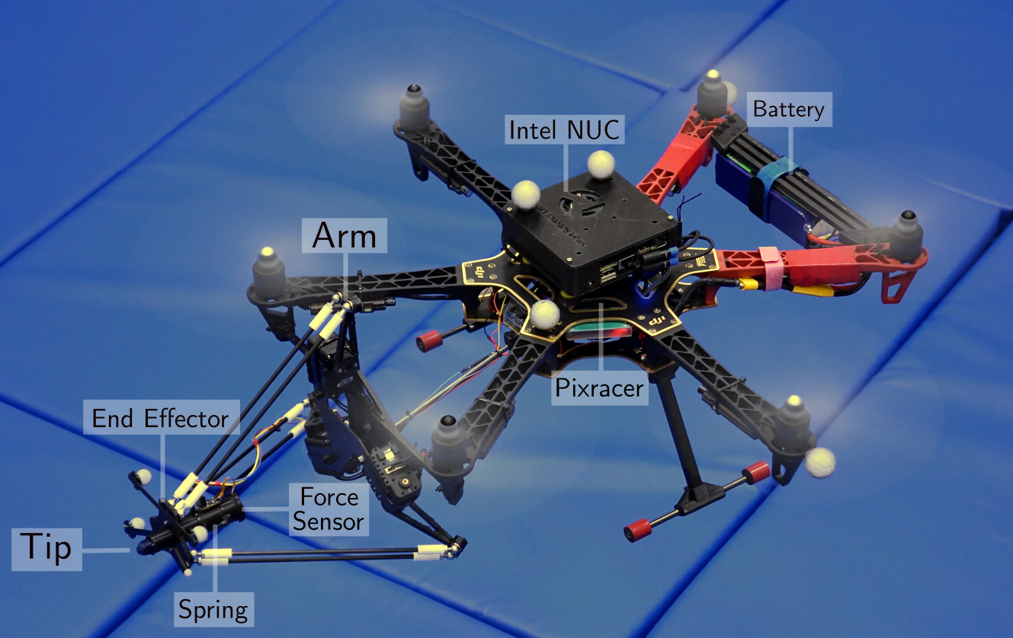
Introduction:
Hybrid Force and Position NMPC Applied to Aerial Writing
Hybrid nonlinear model of combined MAV-arm system
Considers contact forces acting on End Effector
Models moments caused by CoM displacement
Fig. 1: The aerial manipulation platform used in the ‘Aerial Writing’
experiments with labels for its individual components.
Figures, method and results taken from RSS submission (under review, double-blind)
“Aerial Manipulation Using Hybrid Force and Position NMPC Applied to Aerial Writing”
D. Tzoumanikas, F. Graule, Q. Yan, D. Shah, M. Popovic, S. Leutenegger

Slide 6
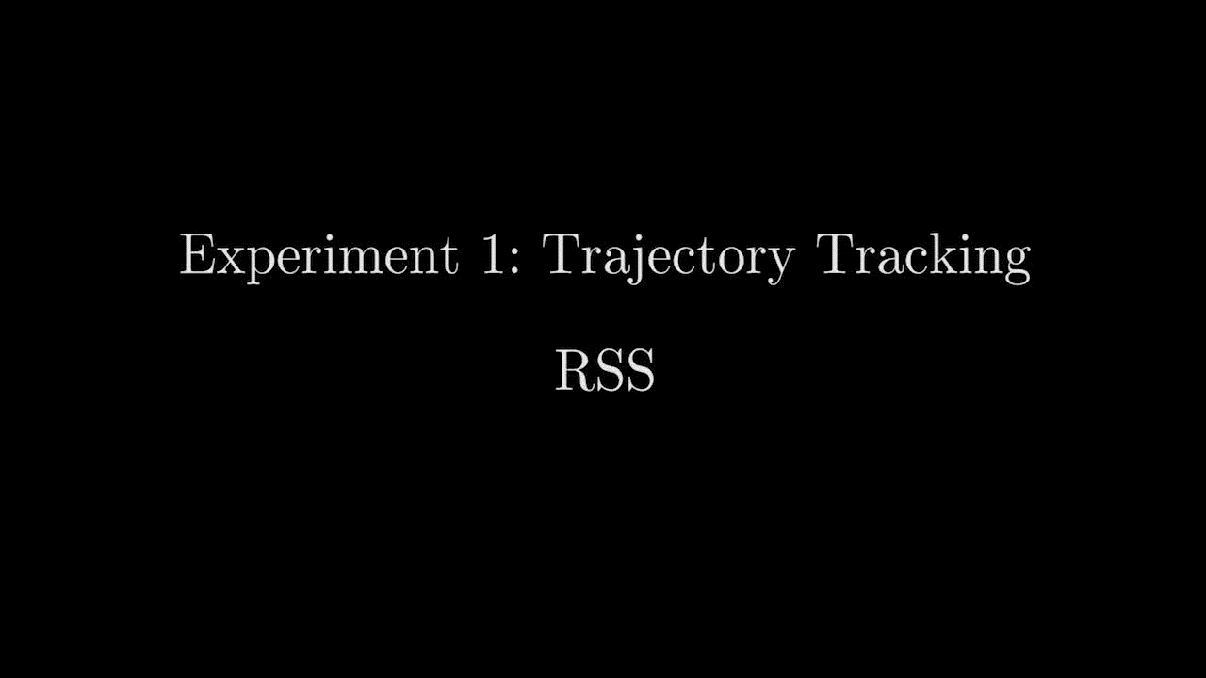
Introduction:
Hybrid Force and Position NMPC Applied to Aerial Writing
Fig. 2: Video summarizing extensive real-world experiments of aerial manipulator while external positioning is used.
Figures, method and results taken from RSS submission (under review, double-blind)
“Aerial Manipulation Using Hybrid Force and Position NMPC Applied to Aerial Writing”
D. Tzoumanikas, F. Graule, Q. Yan, D. Shah, M. Popovic, S. Leutenegger

Slide 7
Introduction:
Contributions
I
II
III
Appearance-based Precision Evaluation for Aerial Writing
Multimodal Feedback for Aerial Writing
Simulation of Aerial Writing for Evaluation

Slide 8
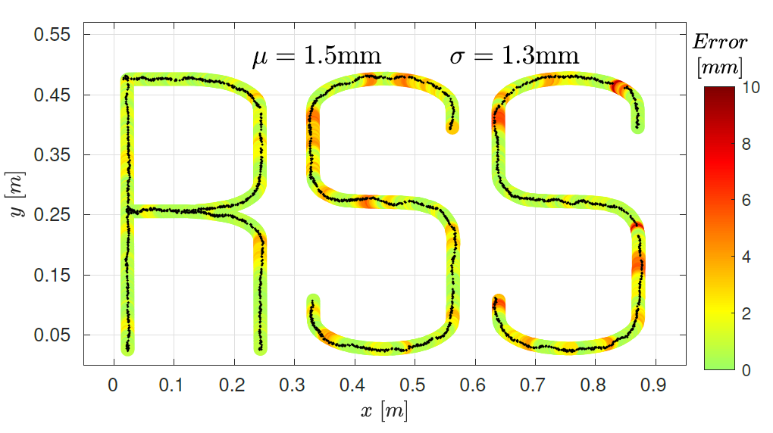
Contribution I:
Appearance-based Precision Evaluation for Aerial Writing
ICP-based visual error to evaluate drawing on Whiteboard
Independent of noise and biases in external pose measurements
Fig. 3: Visual error between the reference and actual tip position for real-world experiment.
Figures, method and results taken from RSS submission (under review, double-blind)
“Aerial Manipulation Using Hybrid Force and Position NMPC Applied to Aerial Writing”
D. Tzoumanikas, F. Graule, Q. Yan, D. Shah, M. Popovic, S. Leutenegger

Slide 9
Introduction:
Three Key Limitations of existing NMPC pipeline
MAV Pose
provided externally
Whiteboard Orientation
sensitive to calibration
Delta Arm Model
not adaptive to offsets
1
2
3

Slide 10
Contribution II:
Multimodal Feedback for Aerial Writing
MAV Pose
provided externally
MAV Position Drift Estimator
Whiteboard Orientation
sensitive to calibration
Whiteboard Orientation Estimator
Delta Arm Model
not adaptive to offsets
Relative End Effector Position Control
1
2
3

Slide 11
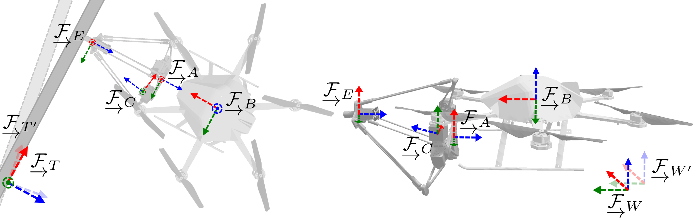

Multimodal Feedback:
Coordinate Frames
MAV body $\underset{→}{ℱ_{B}}$, Arm $\underset{→}{ℱ_{A}}$, End Effector $\underset{→}{ℱ_{E}}$, Camera $\underset{→}{ℱ_{c}}$, World $\underset{→}{ℱ_{W}}$ / $\underset{→}{ℱ_{W´}}$, Touch $\underset{→}{ℱ_{T}}$ / $\underset{→}{ℱ_{T´}}$
Fig. 4: The different coordinate frames used in this presentation.

Slide 12
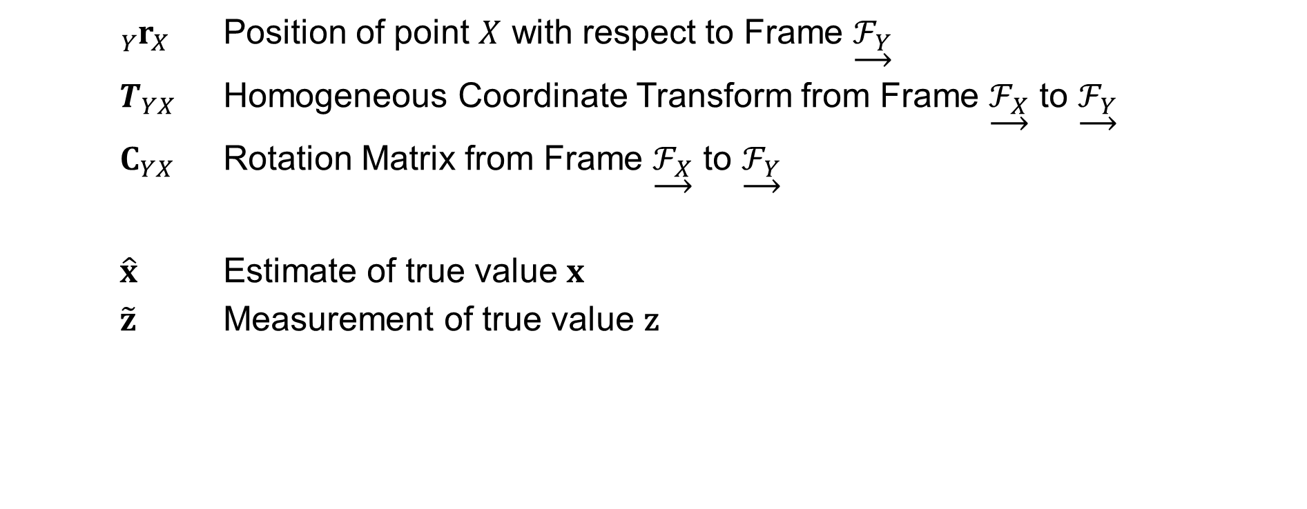
Multimodal Feedback:
Notation
${}_{Y}^{ }{r_{X}}$ Position of point $X$ with respect to Frame $\underset{→}{ℱ_{Y}}$
$T_{YX}$ Homogeneous Coordinate Transform from Frame $\underset{→}{ℱ_{X}}$ to $\underset{→}{ℱ_{Y}}$
$C_{YX}$ Rotation Matrix from Frame $\underset{→}{ℱ_{X}}$ to $\underset{→}{ℱ_{Y}}$
$\hat{x}$ Estimate of true value $x$
$\tilde{z}$ Measurement of true value z

Slide 13
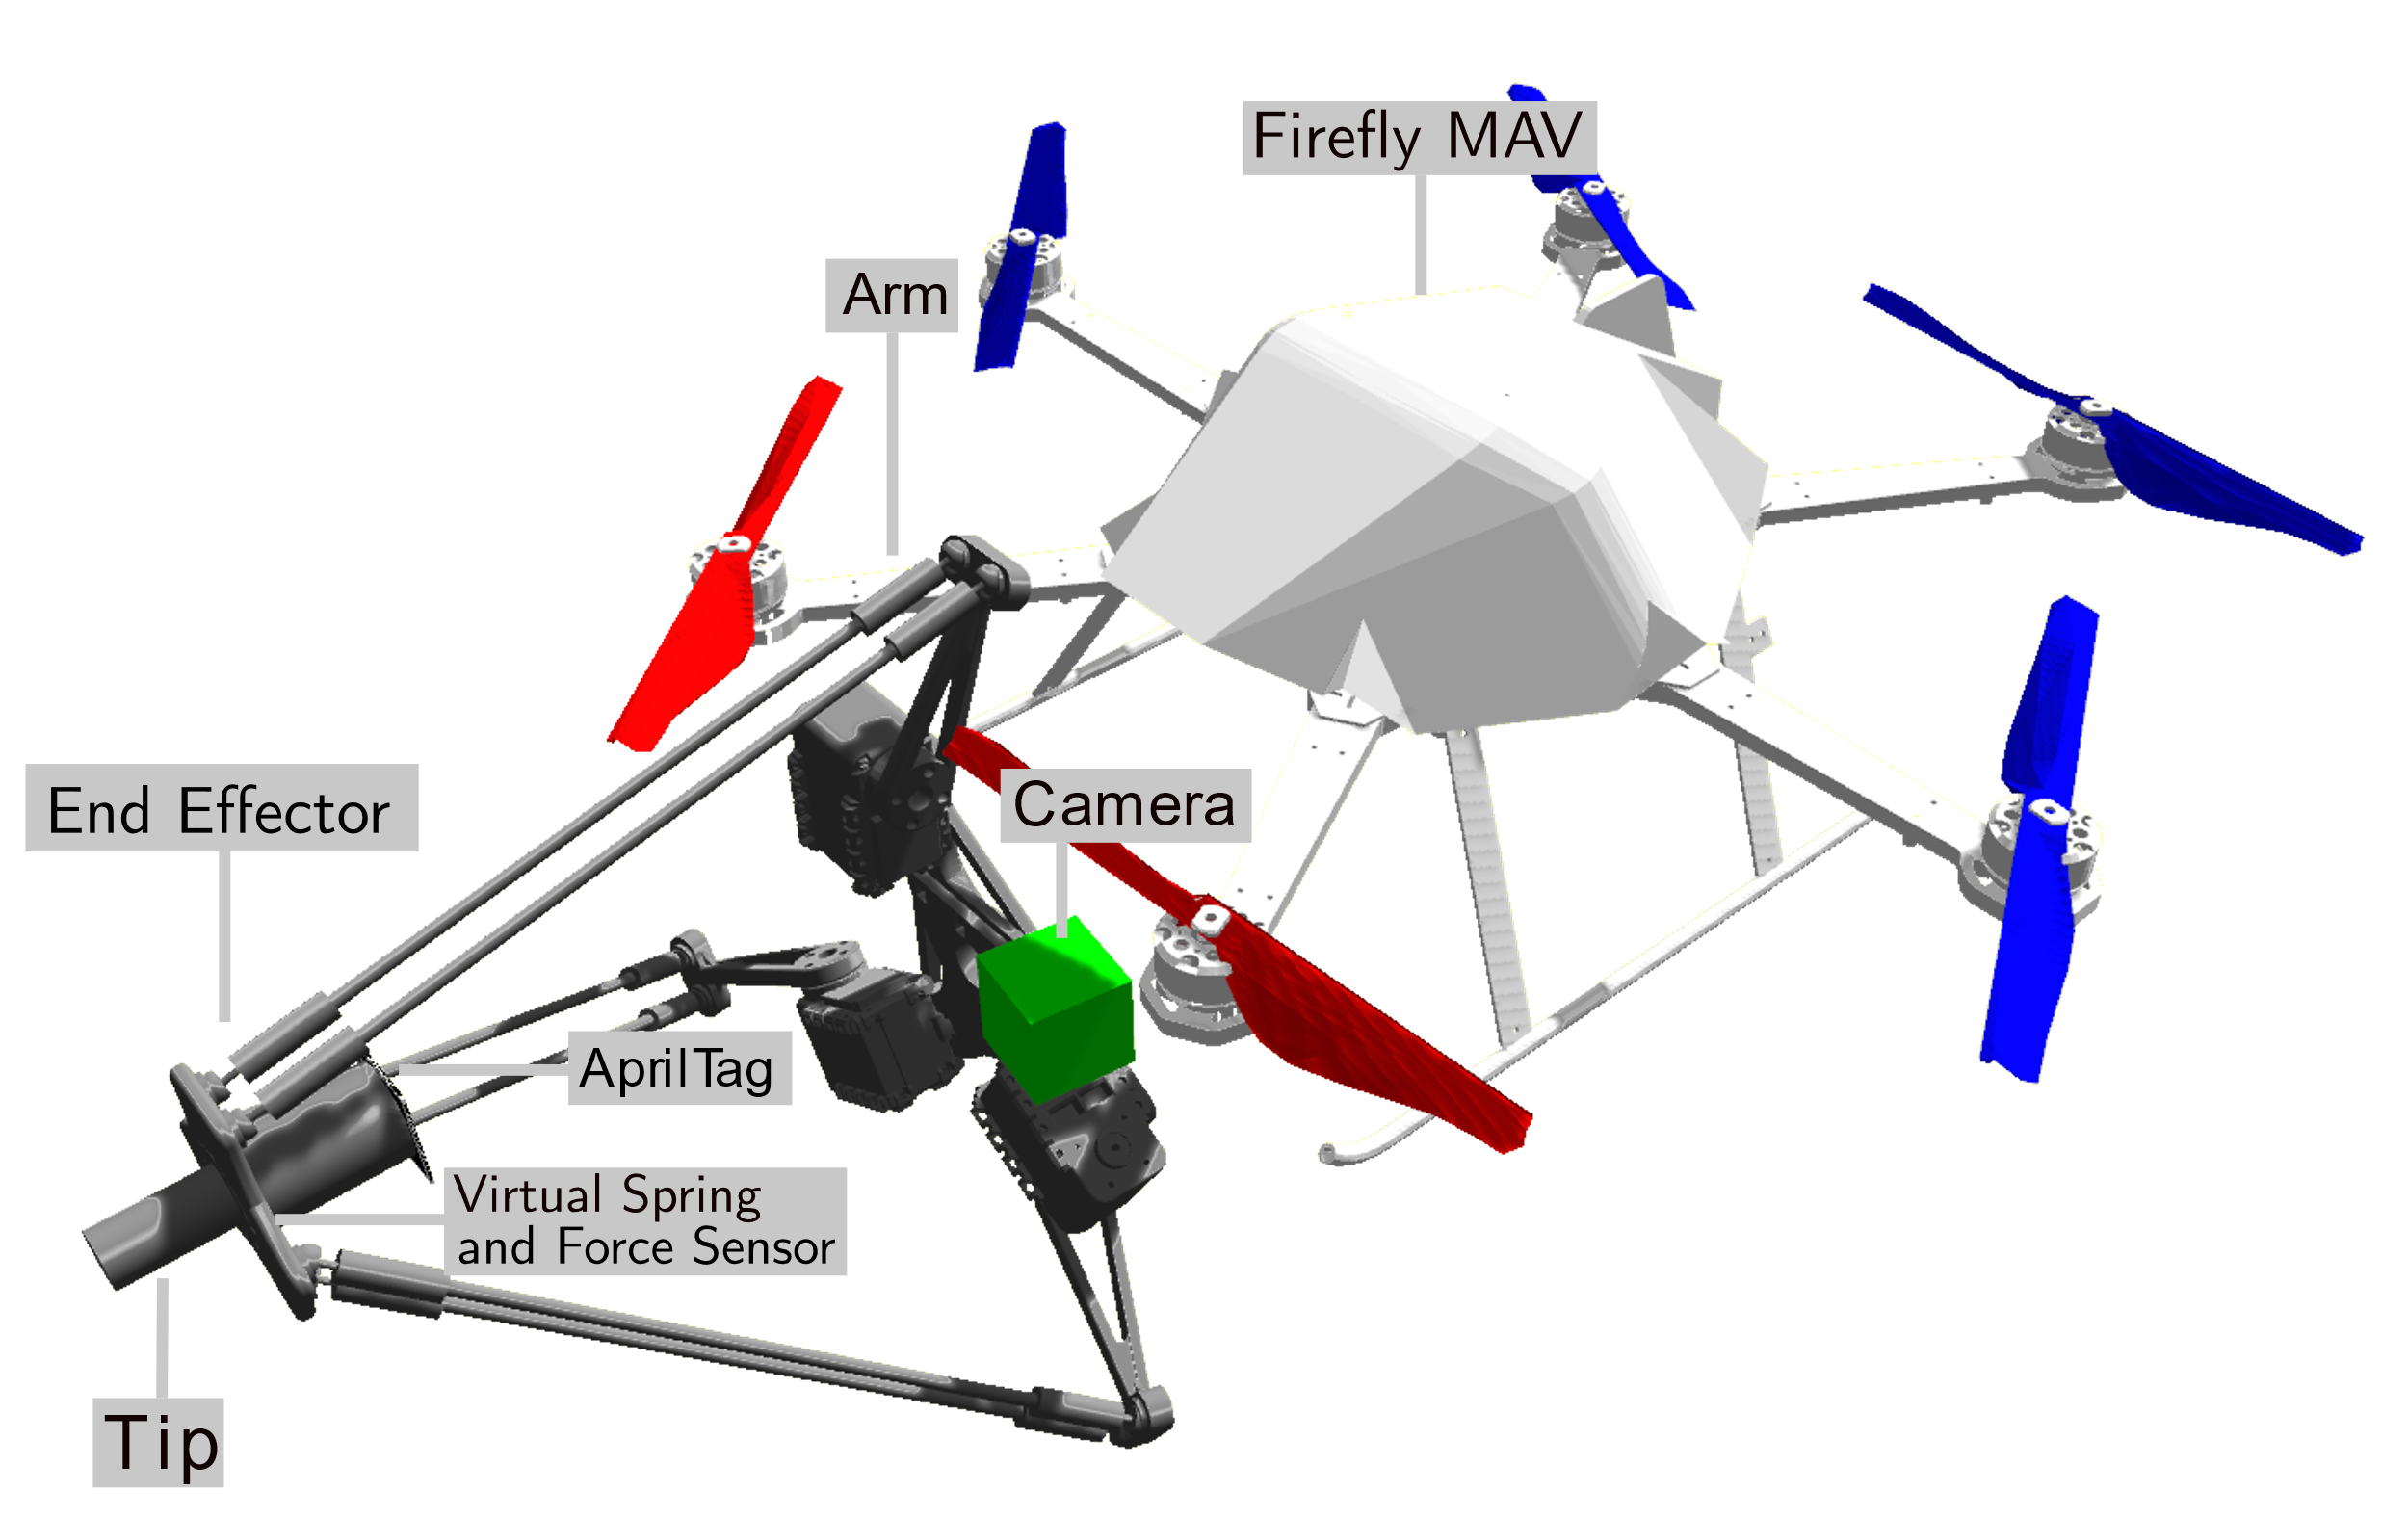
Multimodal Feedback:
Simulation of Aerial Writing
Simulator based on Gazebo and RotorS
Virtual Hexacopter MAV
Accurate replica of Delta Arm with simulated servos and force sensor
Virtual camera
Simulate writing by moving line segments
Fig. 5: The aerial manipulation platform used in the ‘Aerial Writing’
simulations with labels for its individual components.

Slide 14
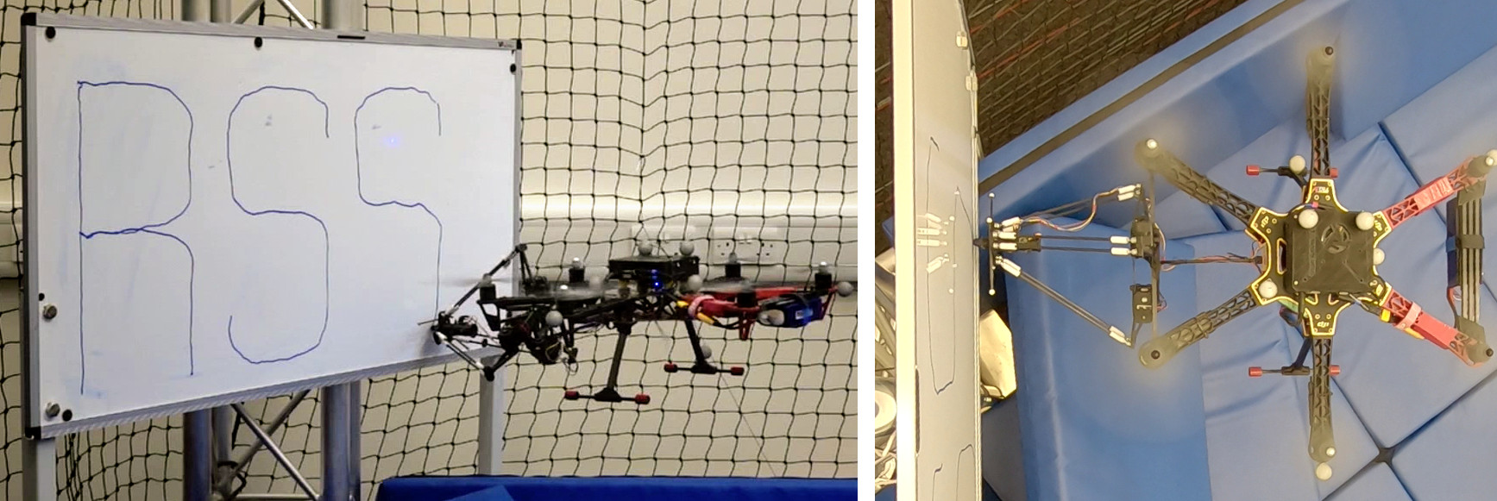
Multimodal Feedback:
Simulation of Aerial Writing
Fig. 6: The MAV-arm system performing an ‘aerial-writing’ task in real-life.

Slide 15
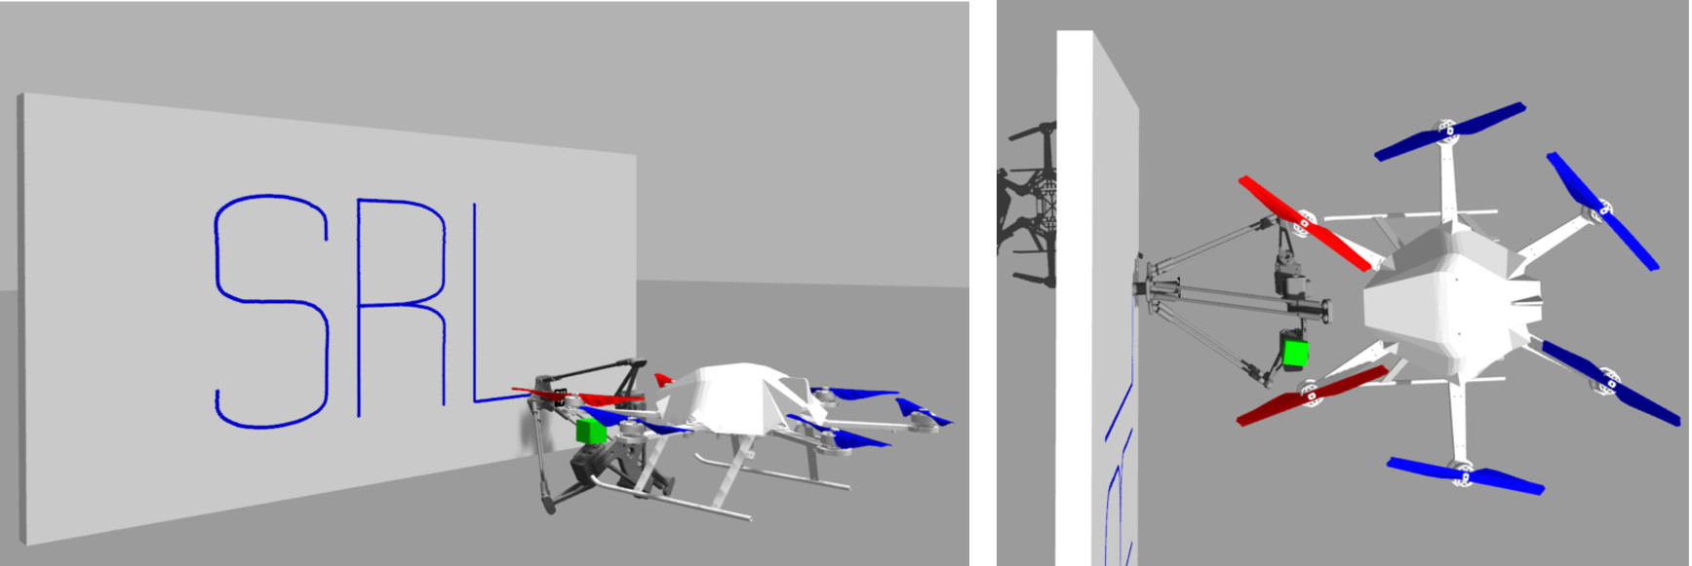
Multimodal Feedback:
Simulation of Aerial Writing
Fig. 7: The MAV-arm system performing an ‘aerial-writing’ task in simulation.

Slide 16
Contribution II:
Multimodal Feedback for Aerial Writing
MAV Pose
provided externally
MAV Position Drift Estimator
Whiteboard Orientation
sensitive to calibration
Whiteboard Orientation Estimator
Delta Arm Model
not adaptive to offsets
Relative End Effector Position Control
1
2
3

Slide 17
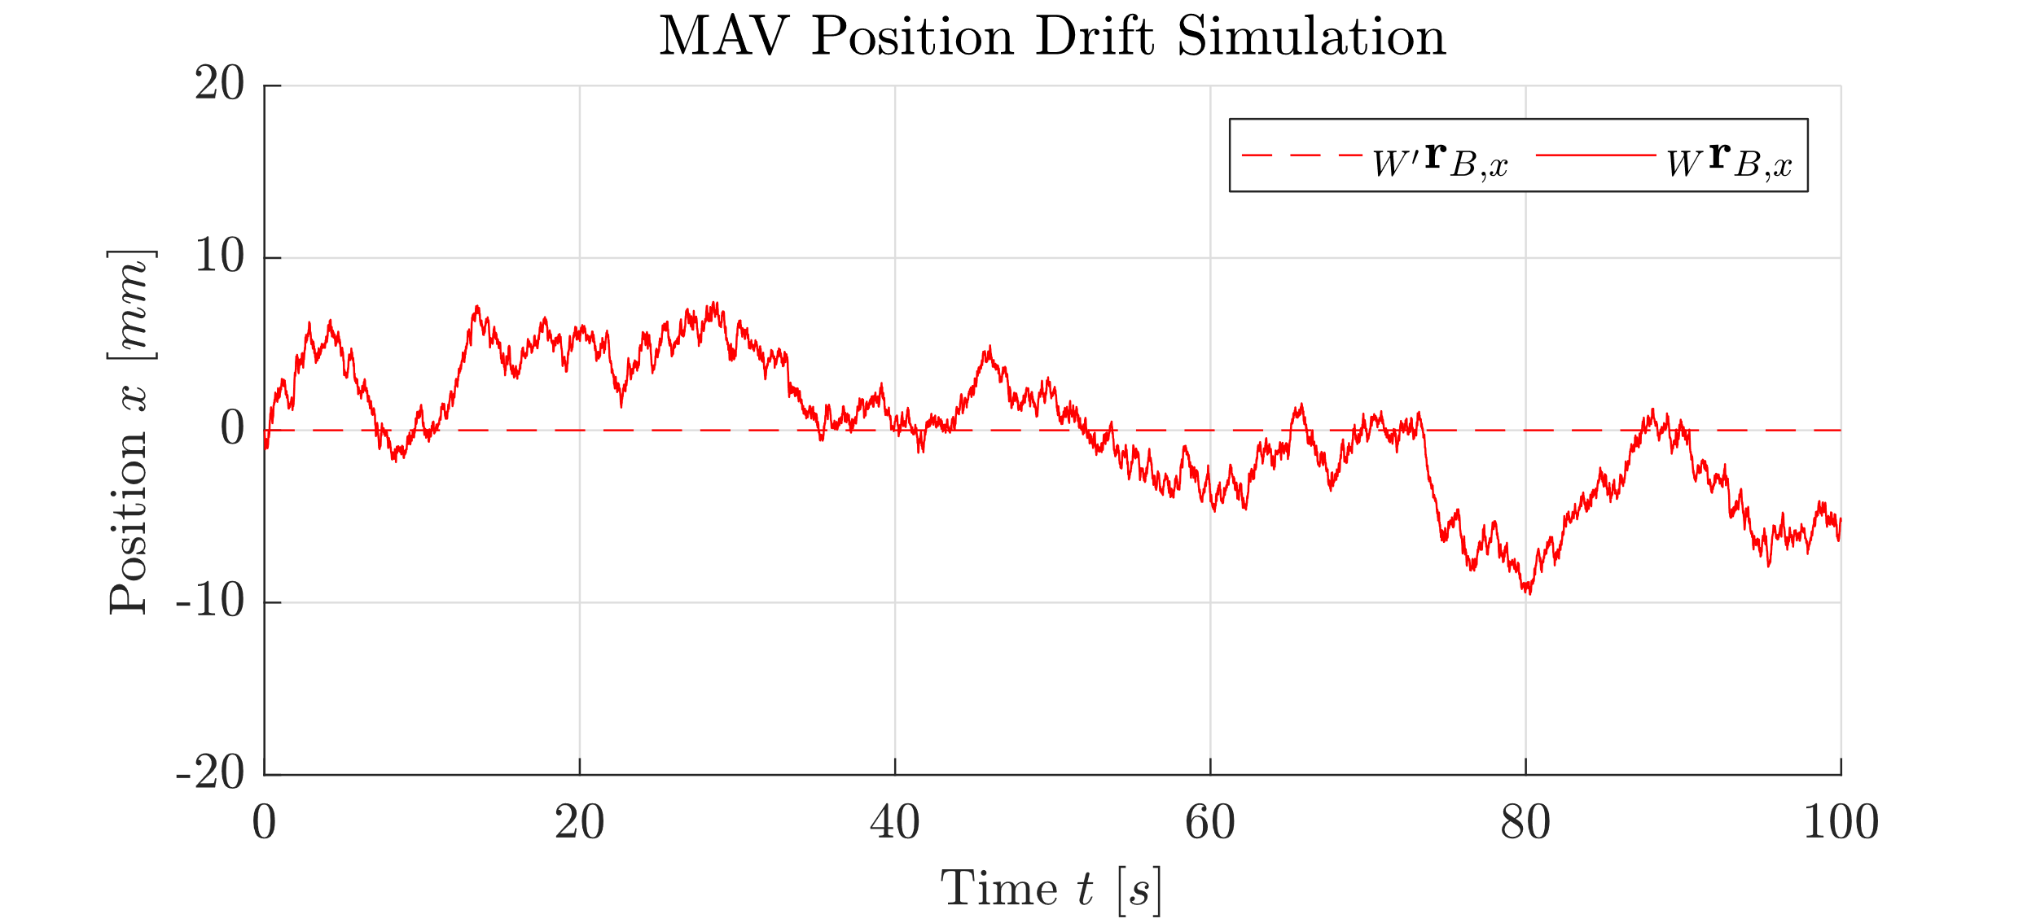
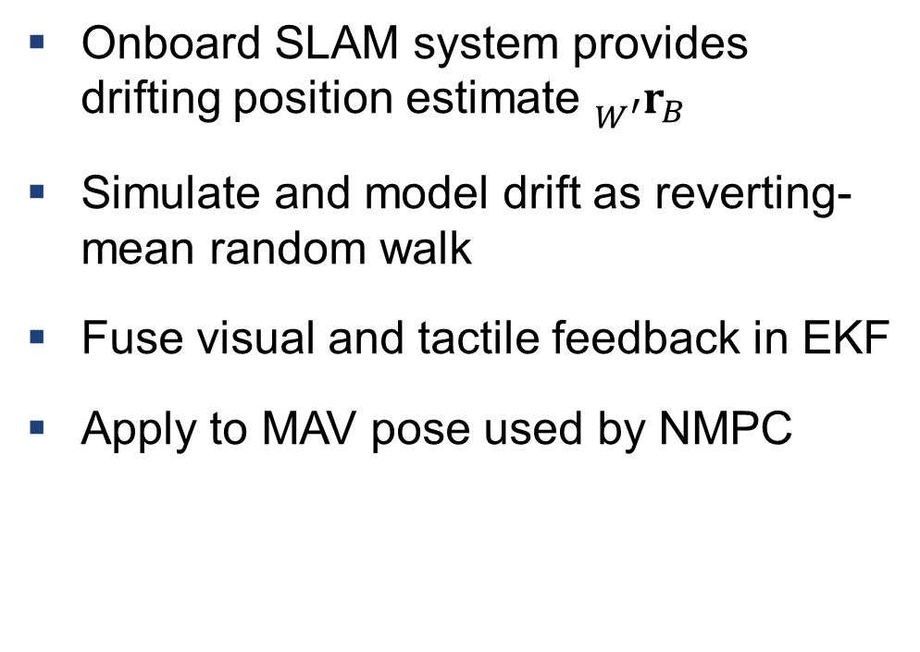
Multimodal Feedback: MAV Position Drift Estimator
Key Idea
Onboard SLAM system provides drifting position estimate ${}_{W^{′}}^{ }{r_{B}}$
Simulate and model drift as reverting-mean random walk
Fuse visual and tactile feedback in EKF
Apply to MAV pose used by NMPC
Fig. 8: Simulated drift on $x$ axis using mean-reverting random walk.

Slide 18
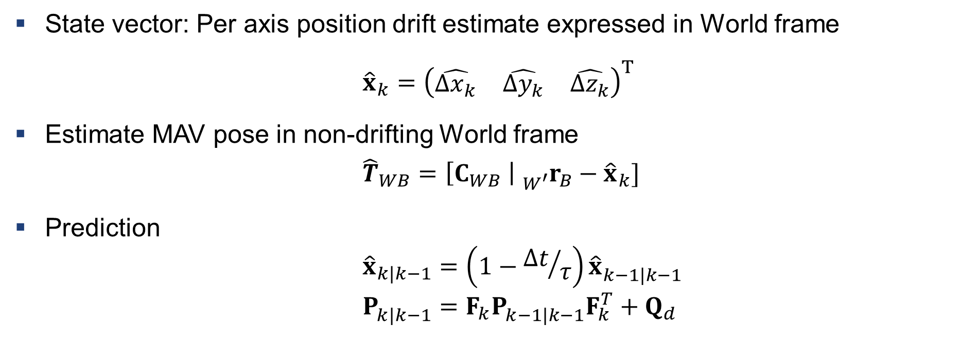
Multimodal Feedback: MAV Position Drift Estimator
Extended Kalman Filter Definition
State vector: Per axis position drift estimate expressed in World frame
${\hat{x}}_{k}={\left(\begin{matrix}\hat{Δx_{k}} & \hat{Δy_{k}} & \hat{Δz_{k}}\end{matrix}\right)}^{T}$
Estimate MAV pose in non-drifting World frame
$${\hat{T}}_{WB}=\left[C_{WB} \right| {}_{W^{′}}^{ }{r_{B}}−{\hat{x}}_{k}]$$
Prediction
$${\hat{x}}_{k|k−1}=\left(1−{Δt}/τ\right){\hat{x}}_{k−1|k−1}^{ }$$
$$P_{k|k−1}^{ }=F_{k}P_{k−1|k−1}^{ }F_{k}^{T}+Q_{d}$$

Slide 19
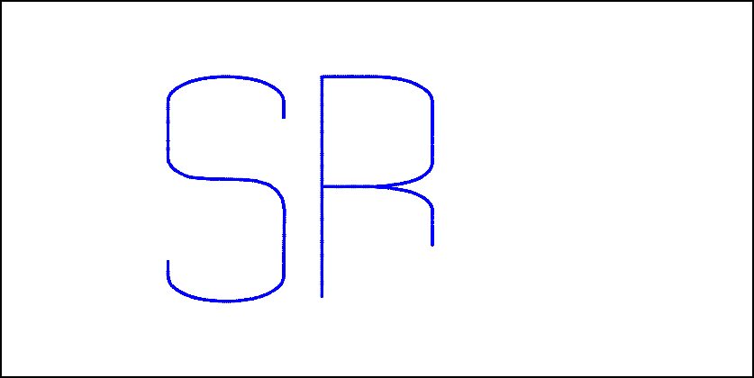
Multimodal Feedback: MAV Position Drift Estimator
Visual Measurement
Reference drawing on Whiteboard
What should have been written so far?
Fig. 9: Reference drawing on Whiteboard at current time.

Slide 20
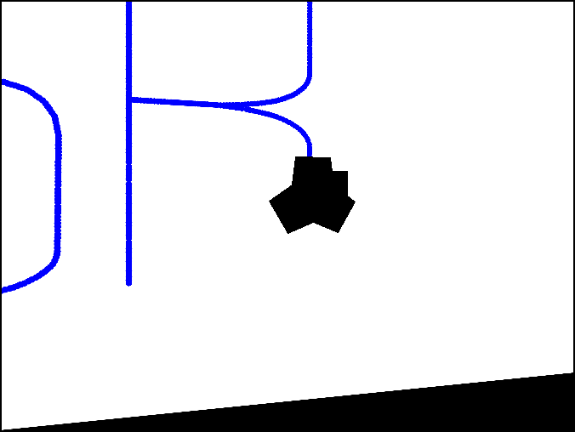
Multimodal Feedback: MAV Position Drift Estimator
Visual Measurement
Reference drawing on Whiteboard
What should have been written so far?
Project into estimated camera and masked
What should the camera be seeing now?
Fig. 10: Reference drawing projected into virtual camera and masked out.

Slide 21
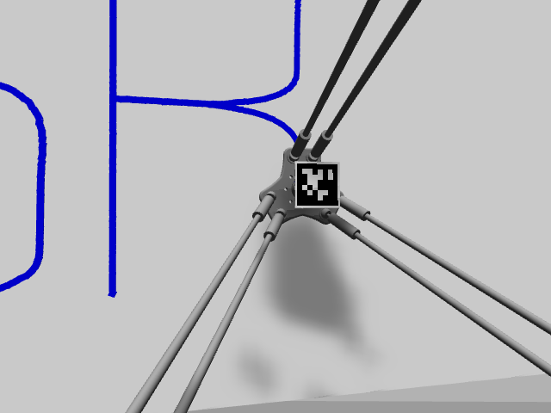
Multimodal Feedback: MAV Position Drift Estimator
Visual Measurement
Reference drawing on Whiteboard
What should have been written so far?
Project into estimated camera and masked
What should the camera be seeing now?
Current camera frame
What is the camera actually seeing now?
Fig. 11: Current frame perceived by the camera.

Slide 22
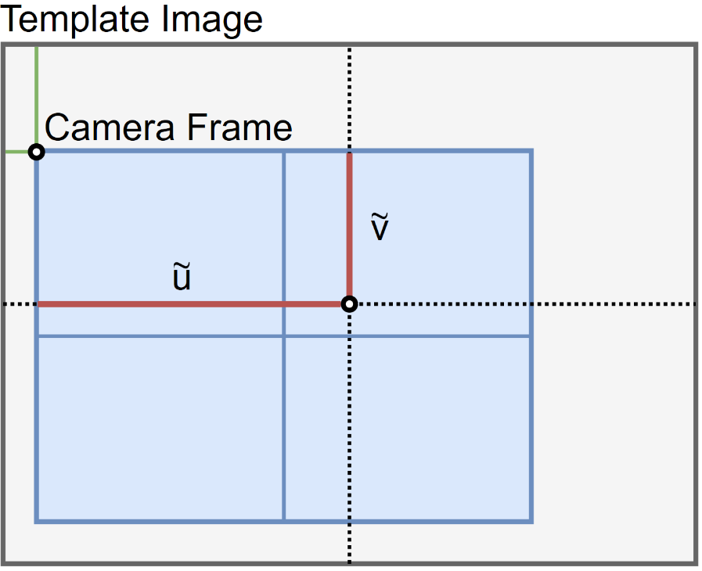
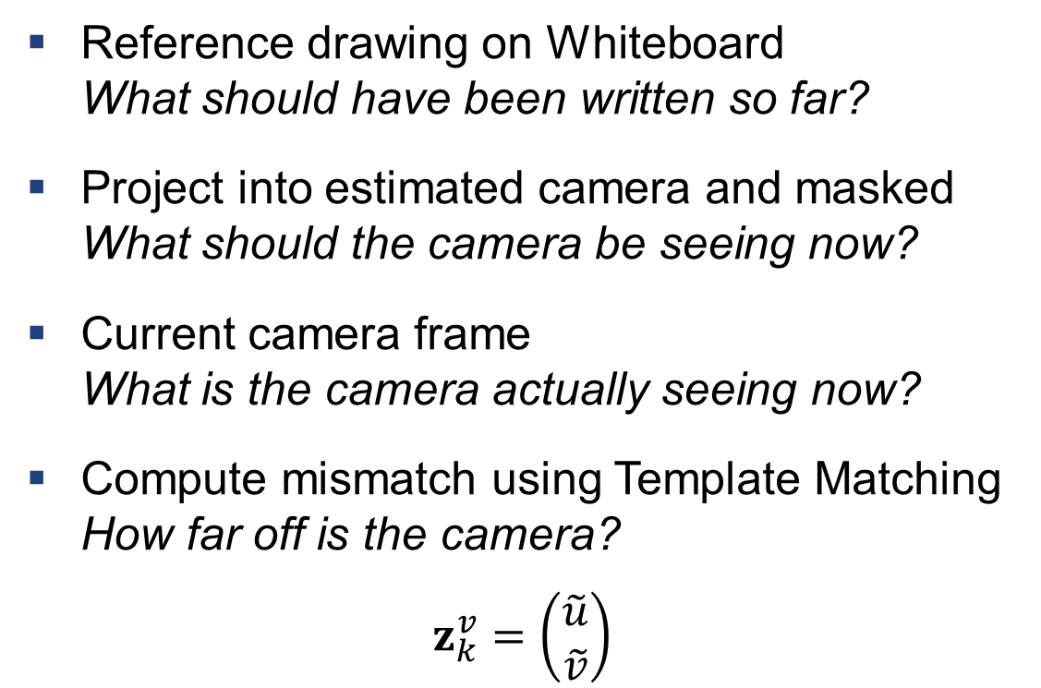
Multimodal Feedback: MAV Position Drift Estimator
Visual Measurement
Reference drawing on Whiteboard
What should have been written so far?
Project into estimated camera and masked
What should the camera be seeing now?
Current camera frame
What is the camera actually seeing now?
Compute mismatch using Template Matching
How far off is the camera?
$$z_{k}^{v}=\left(\begin{matrix}\tilde{u} \\ \tilde{v}\end{matrix}\right)$$
Fig. 12: Illustration of visual measurement in pixel space with
camera frame overlaying rendered template image.

Slide 23
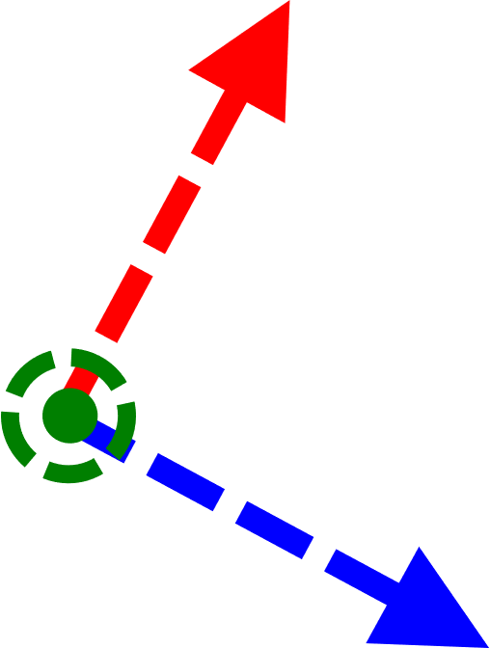

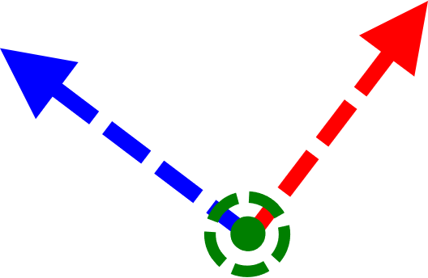
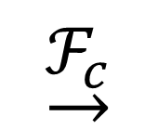
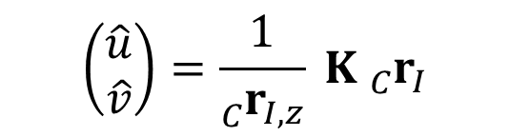




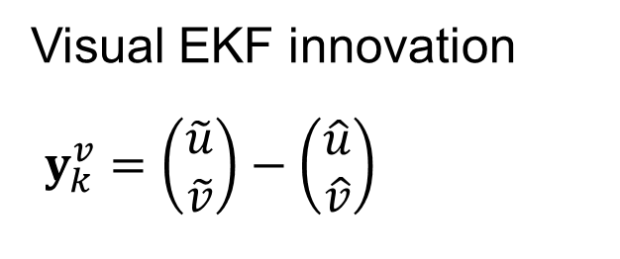
Multimodal Feedback: MAV Position Drift Estimator
Visual Measurement
$$T_{CB}{\left({\hat{T}}_{WB}\right)}^{−1}T_{WT}$$
$${}_{T}^{ }{r_{I}}$$
$${}_{C}^{ }{r_{I}}$$
$$\underset{→}{ℱ_{T}}$$
$$\left(\begin{matrix}\hat{u} \\ \hat{v}\end{matrix}\right)=\frac{1}{{}_{C}^{ }{r_{I,z}}} K {}_{C}^{ }{r_{I}}$$
$$\underset{→}{ℱ_{c}}$$
Visual EKF innovation
$y_{k}^{v}=\left(\begin{matrix}\tilde{u} \\ \tilde{v}\end{matrix}\right)−\left(\begin{matrix}\hat{u} \\ \hat{v}\end{matrix}\right)$

Slide 24
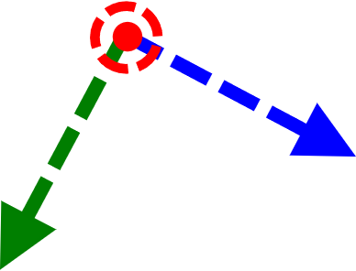
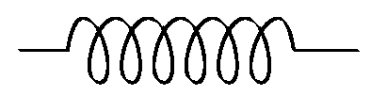
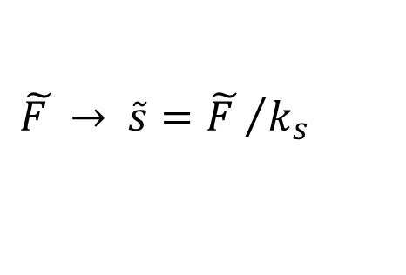
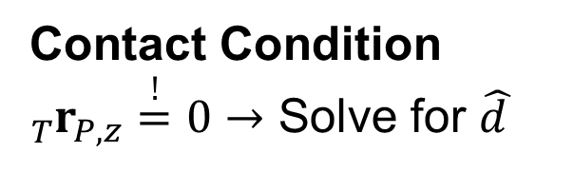



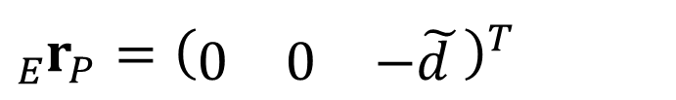

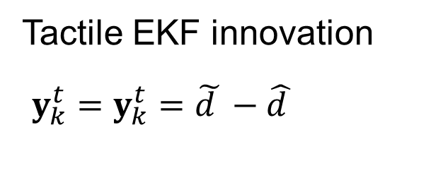


Multimodal Feedback: MAV Position Drift Estimator
Tactile Measurement
$$T_{TW}{\hat{T}}_{WB}T_{BA}T_{AE}$$
$${}_{E}^{ }{r_{P}}={\left(\begin{matrix}0 & 0 & −\tilde{d }\end{matrix}\right)}^{T}$$
$${}_{T}^{ }{r_{P}}$$
$$\underset{→}{ℱ_{T}}$$
$$D$$
$$\tilde{d }=D−\tilde{s}$$
Contact Condition
${}_{T}^{ }{r_{P,z}\overset{!}{=}0}→$ Solve for $\hat{d }$
$$\underset{→}{ℱ_{E}}$$
$$\tilde{s}$$
Tactile EKF innovation
$y_{k}^{t}=y_{k}^{t}=\tilde{d }−\hat{d }$
End Effector
$$\tilde{F }→ \tilde{s}={\tilde{F }}/{k_{s}}$$

Slide 25
Contribution II:
Multimodal Feedback for Aerial Writing
MAV Pose
provided externally
MAV Position Drift Estimator
Whiteboard Orientation
sensitive to calibration
Whiteboard Orientation Estimator
Delta Arm Model
not adaptive to offsets
Relative End Effector Position Control
1
2
3

Slide 26
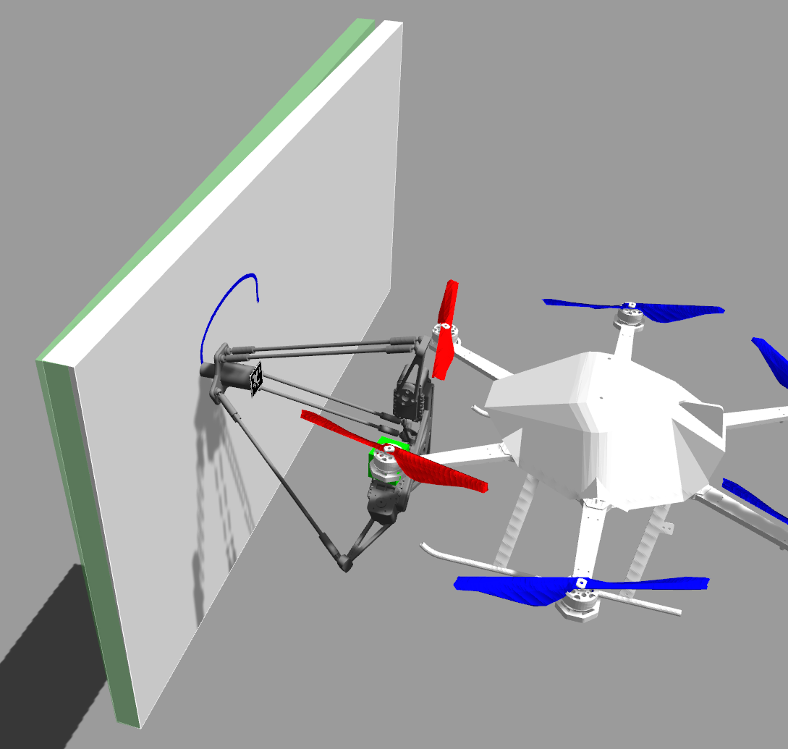
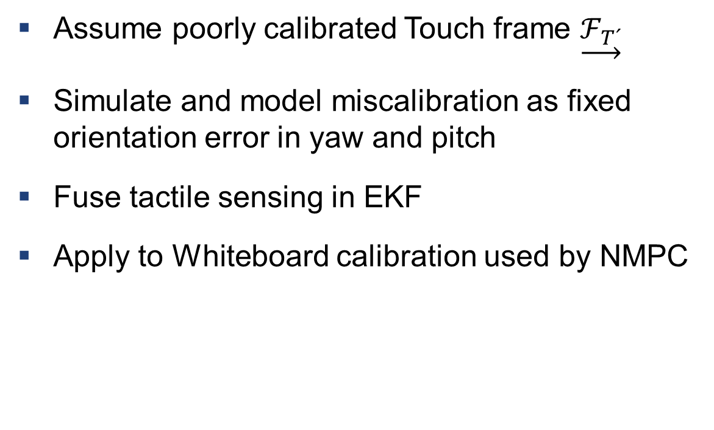
Multimodal Feedback: Whiteboard Orientation Estimator
Key Idea
Assume poorly calibrated Touch frame $\underset{→}{ℱ_{T´}}$
Simulate and model miscalibration as fixed orientation error in yaw and pitch
Fuse tactile sensing in EKF
Apply to Whiteboard calibration used by NMPC
Fig. 13: Aerial Writing simulation with actual Whiteboard with orientation offset in white and wrongly calibrated estimate in green.

Slide 27
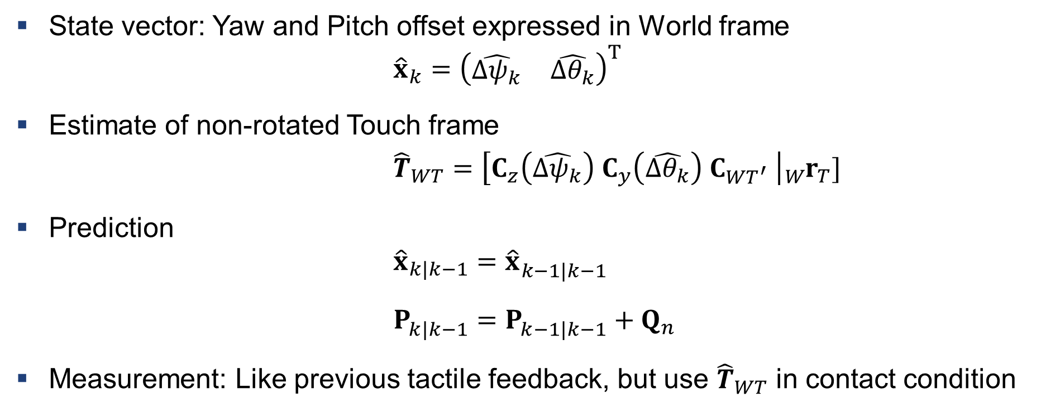
Multimodal Feedback: Whiteboard Orientation Estimator
Extended Kalman Filter Definition
State vector: Yaw and Pitch offset expressed in World frame
$${\hat{x}}_{k}={\left(\begin{matrix}\hat{Δψ_{k}} & \hat{Δθ_{k}}\end{matrix}\right)}^{T}$$
Estimate of non-rotated Touch frame
$${\hat{T}}_{WT}=\left[C_{z}\left(\hat{Δψ_{k}}\right) C_{y}\left(\hat{Δθ_{k}}\right) C_{WT^{′}} \right|{}_{W}^{ }{r_{T}}]$$
Prediction
$${\hat{x}}_{k|k−1}={\hat{x}}_{k−1|k−1}^{ }$$
$P_{k|k−1}^{ }=P_{k−1|k−1}^{ }+Q_{n}$
Measurement: Like previous tactile feedback, but use ${\hat{T}}_{WT}$ in contact condition

Slide 28
Contribution II:
Multimodal Feedback for Aerial Writing
MAV Pose
provided externally
MAV Position Drift Estimator
Whiteboard Orientation
sensitive to calibration
Whiteboard Orientation Estimator
Delta Arm Model
not adaptive to offsets
Relative End Effector Position Control
1
2
3

Slide 29
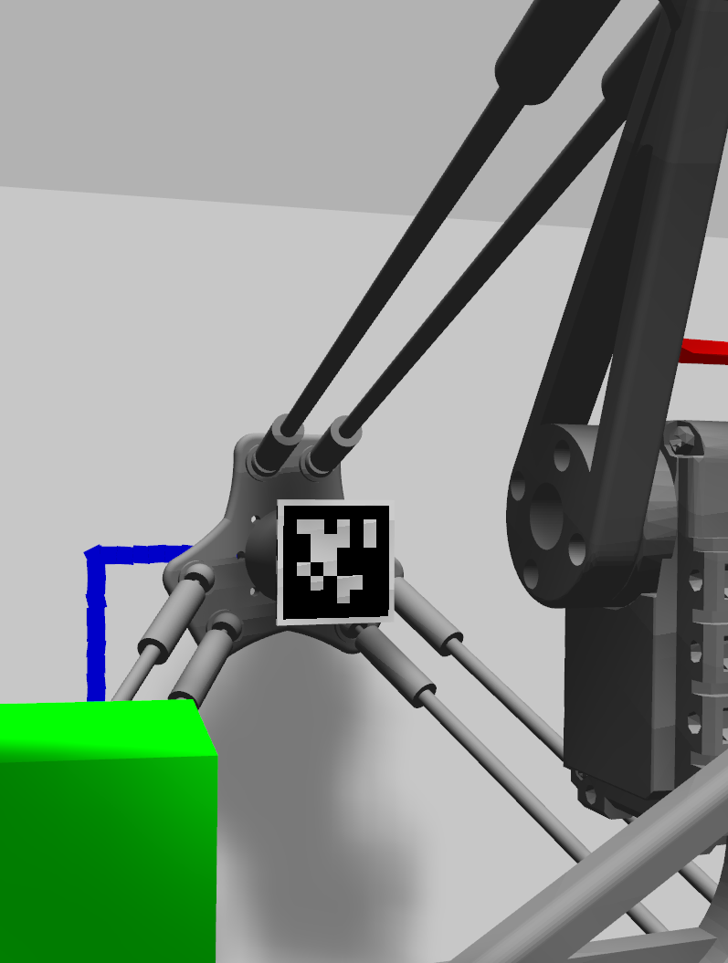
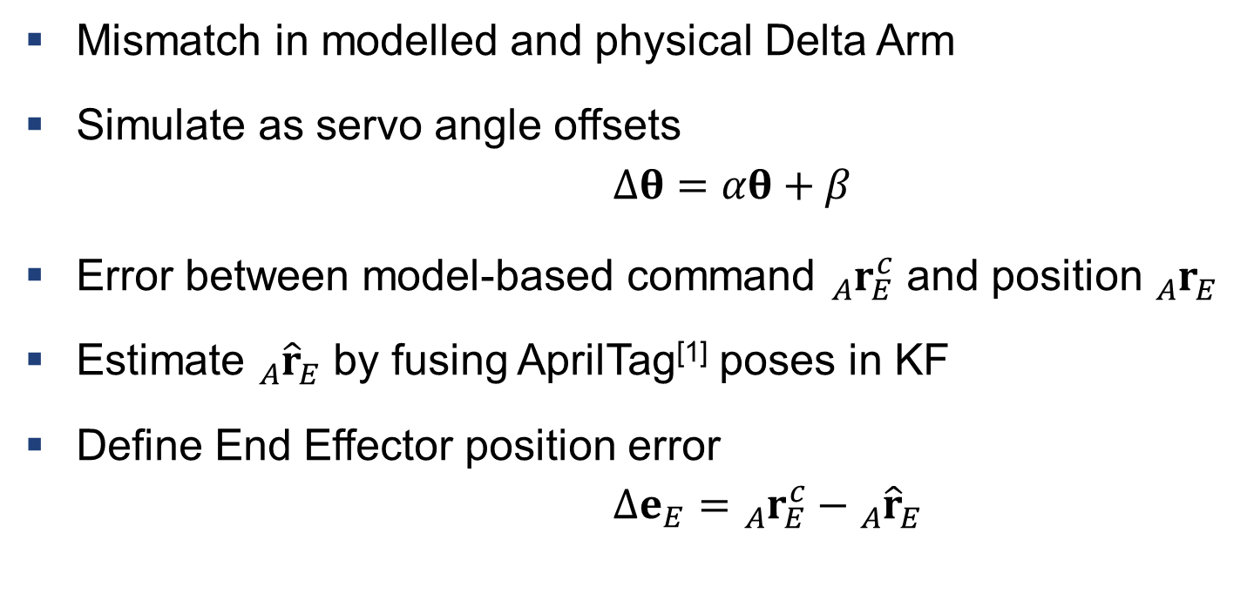
Multimodal Feedback: Relative End Effector Position Control
Key Idea
Mismatch in modelled and physical Delta Arm
Simulate as servo angle offsets
$$Δθ=αθ+β$$
Error between model-based command ${}_{A}^{ }{r_{E}^{c}}$ and position ${}_{A}^{ }{r_{E}^{ }}$
Estimate ${}_{A}^{ }{{\hat{r}}_{E}^{ }}$ by fusing AprilTag^{[1]} poses in KF
Define End Effector position error
$$Δe_{E}={}_{A}^{ }{r_{E}^{c}}−{}_{A}^{ }{{\hat{r}}_{E}^{ }}$$
Fig. 14: The components involved, i.e. the camera (green), the AprilTag mounted on the End Effector and one of the three servos.
[1] J. Wang and E. Olson, "AprilTag 2: Efficient and robust fiducial detection," IROS 2016
D. Malyuta. “Guidance, Navigation, Control and Mission Logic for Quadrotor Full-cycle Autonomy.”, 2018.

Slide 30
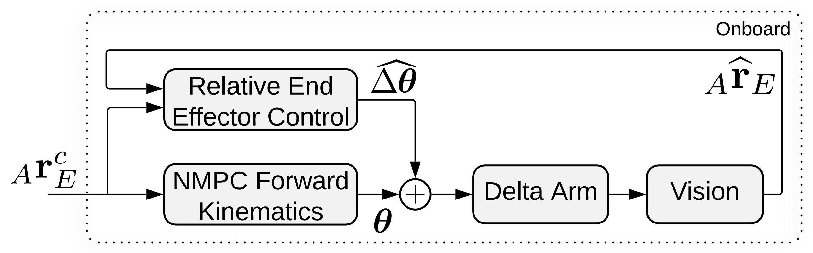

Multimodal Feedback: Relative End Effector Position Control
End Effector Position Control
Map to angle offsets using Delta Arm Jacobian
$$\hat{Δθ}=J_{a} Δe_{E}$$
Local feedback loop for Delta Arm cascaded around NMPC
Fig. 15: Overview of simulated tactile measurement hardware.

Slide 31
Contribution III:
Simulation of Aerial Writing for Evaluation
MAV Position Drift Estimator
Whiteboard Orientation Estimator
Relative End Effector Position Control
1
2
3

Slide 32
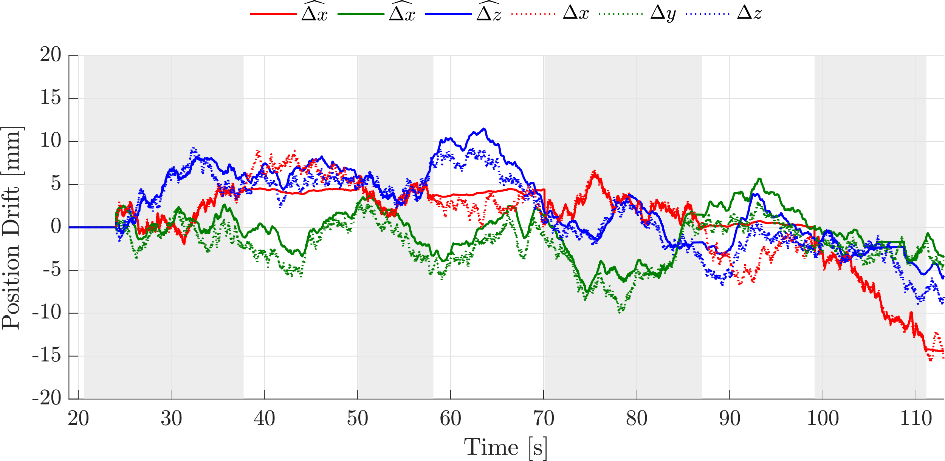
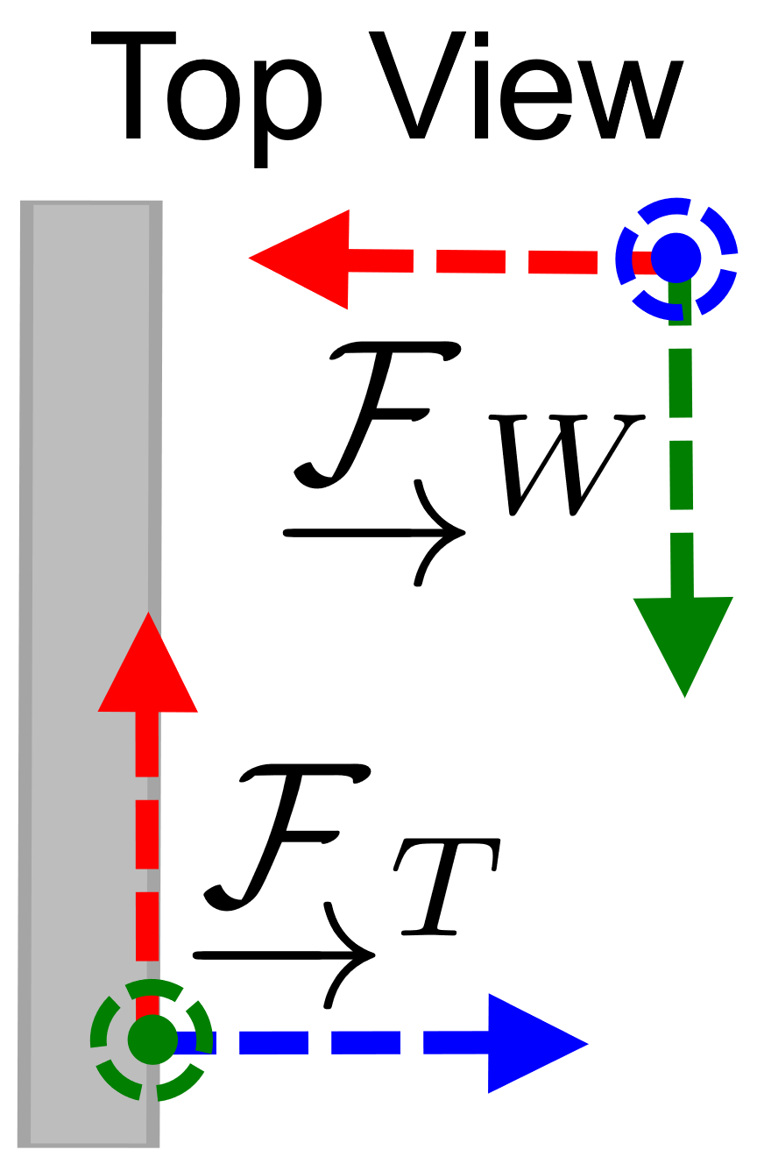
Results:
MAV Position Drift Estimator
Simulate | Drift
Estimate | Drift
Fig. 16: True and estimated MAV Position Drift with Estimator turned on.

Slide 33
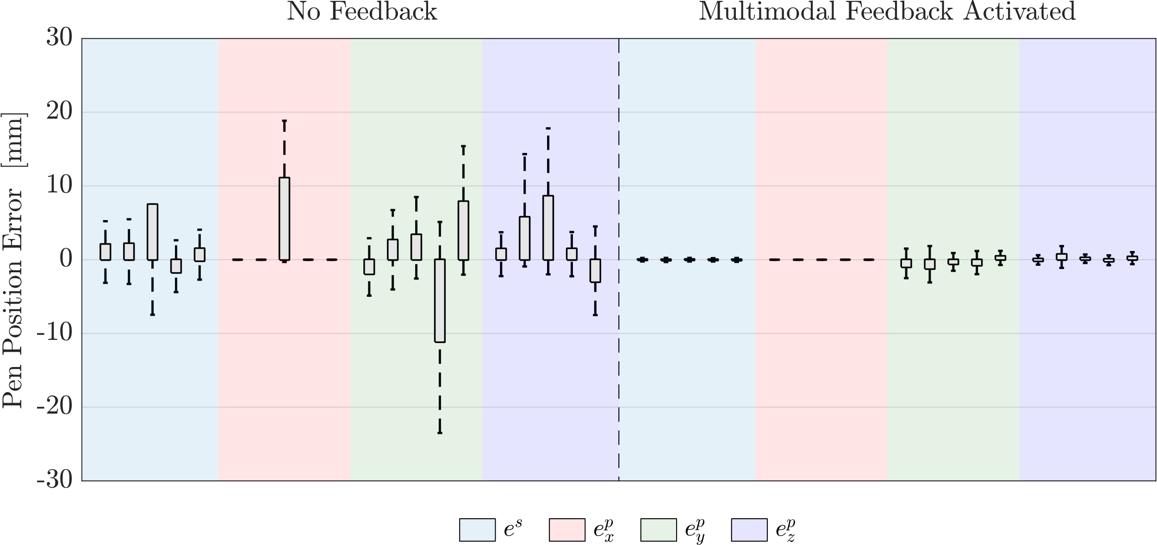
Results:
MAV Position Drift Estimator
Fig. 17: Box Plots of Spring and Pen Tracking Errors while simulating MAV Position Drift with Estimator being off (left) or on (right).

Slide 34
Contribution III:
Simulation of Aerial Writing for Evaluation
MAV Position Drift Estimator
Whiteboard Orientation Estimator
Relative End Effector Position Control
1
2
3

Slide 35
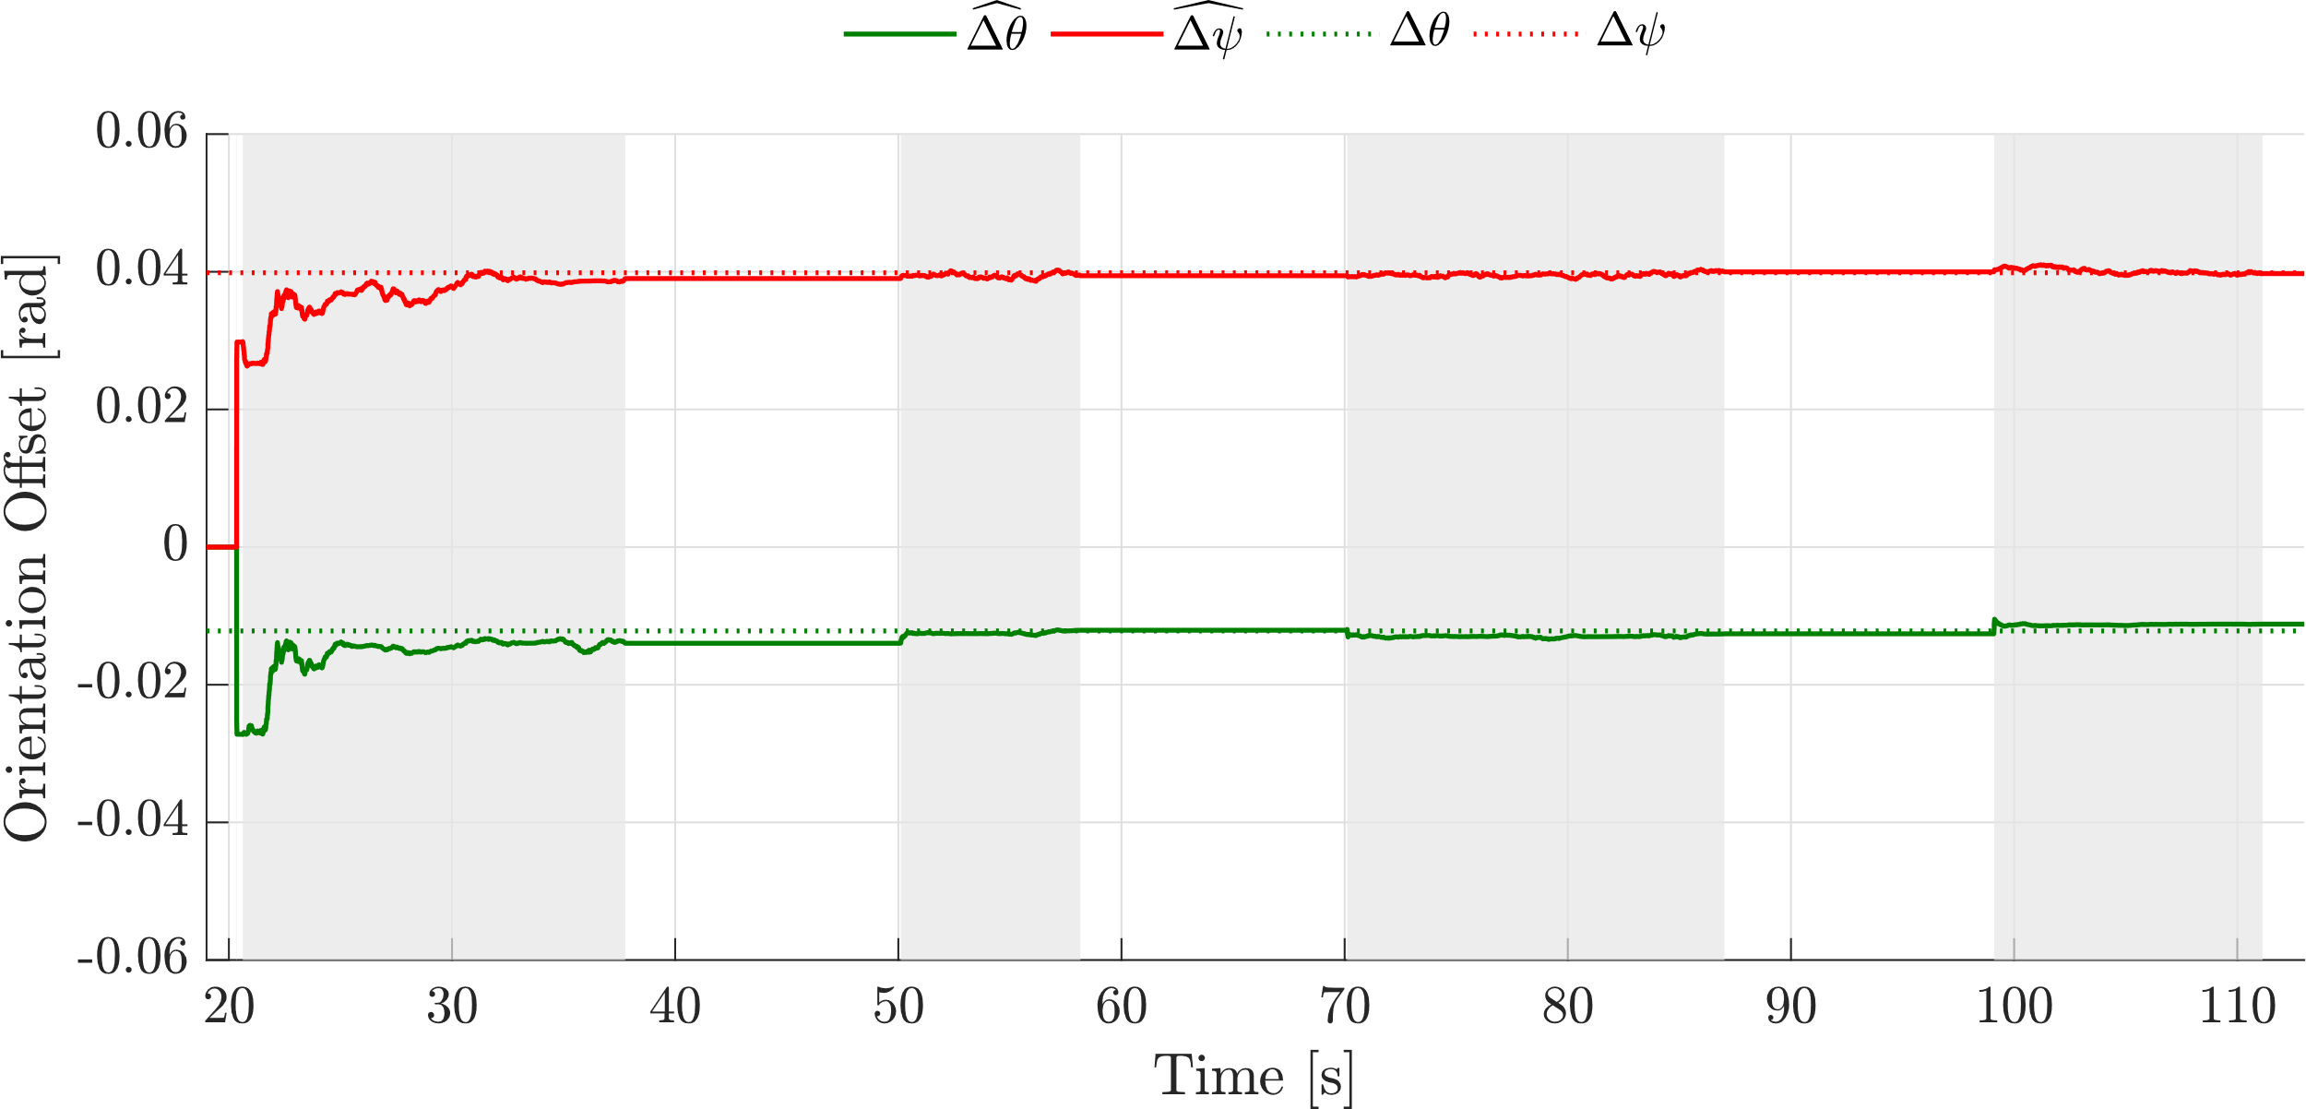
Results:
Whiteboard Orientation Estimator
Simulate | Whiteboard
Estimate | Whiteboard
Fig. 18: True and estimated Whiteboard Orientation Offset with Estimator turned on.

Slide 36
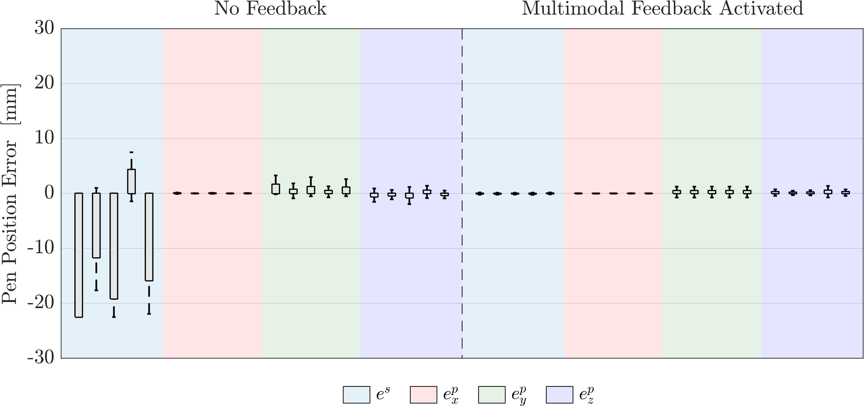
Results:
Whiteboard Orientation Estimator
Fig. 19: Box Plots of Spring and Pen Tracking Errors while simulating Whiteboard Orientation Offsets with Estimator being off (left) or on (right).

Slide 37
Contribution III:
Simulation of Aerial Writing for Evaluation
MAV Position Drift Estimator
Whiteboard Orientation Estimator
Relative End Effector Position Control
1
2
3

Slide 38
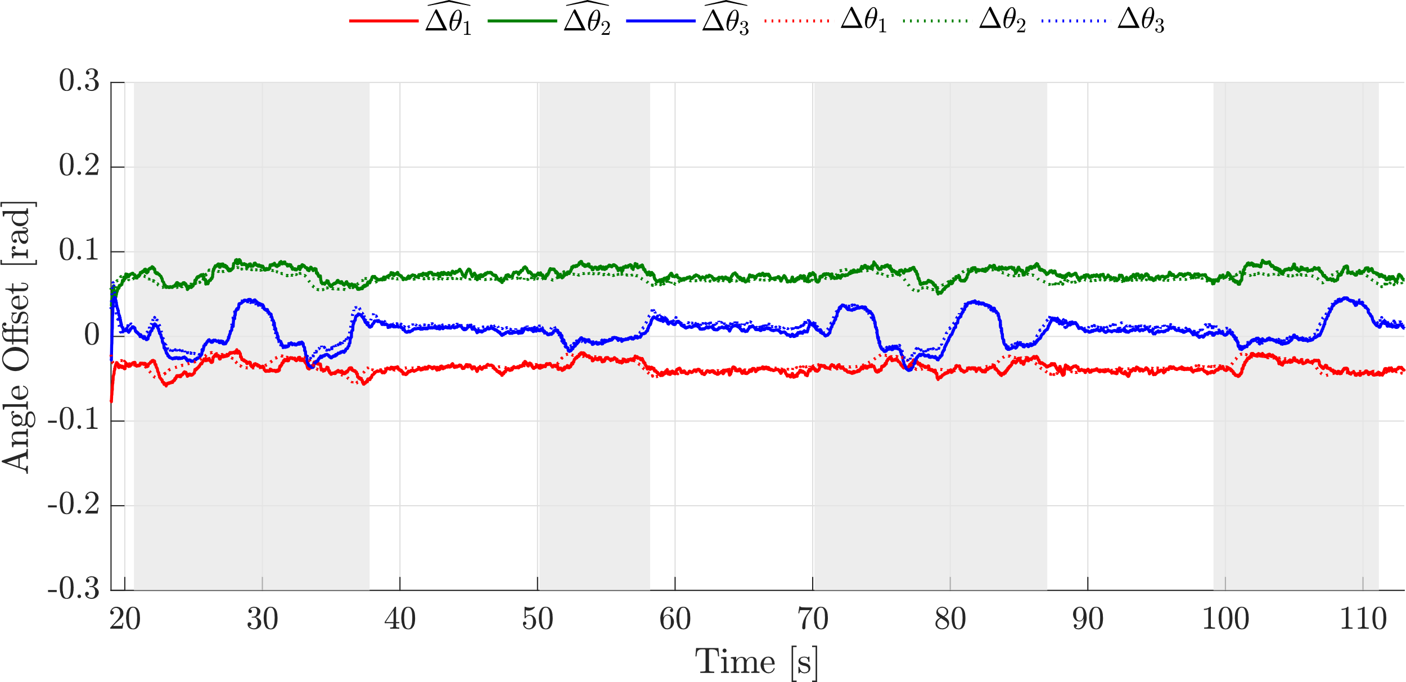
Results:
Relative End Effector Position Control
Simulate | Servo
Estimate | Servo
Fig. 20: True and estimated Servo Angle Offsets with Estimator turned on.

Slide 39
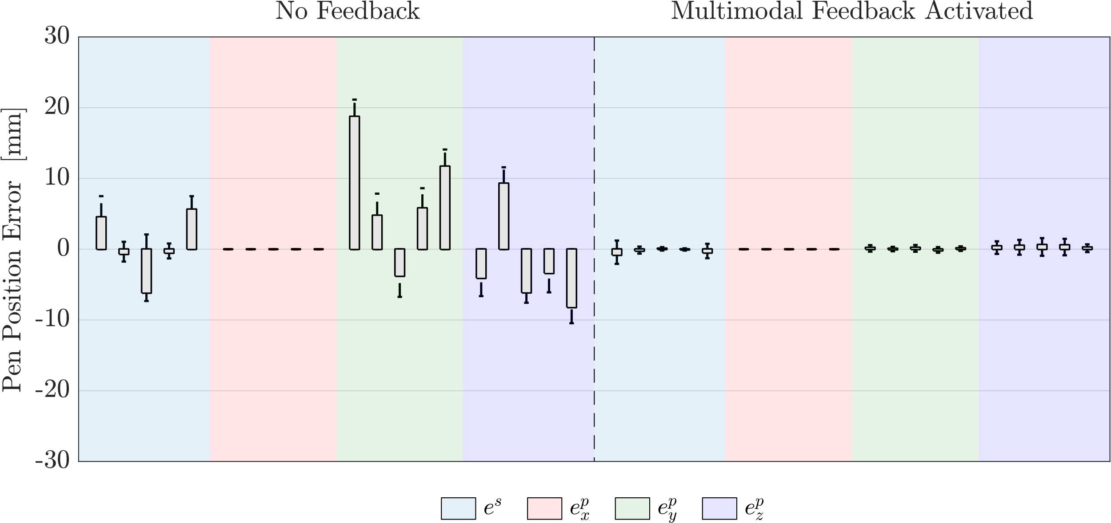
Results:
Relative End Effector Position Control
Fig. 21: Box Plots of Spring and Pen Tracking Errors while simulating Servo Angle Offsets with Relative Control being off (left) or on (right).

Slide 40
Contribution III:
Simulation of Aerial Writing for Evaluation
MAV Position Drift Estimator
Whiteboard Orientation Estimator
Relative End Effector Position Control
1
2
3
Combine all Error Sources

Slide 41
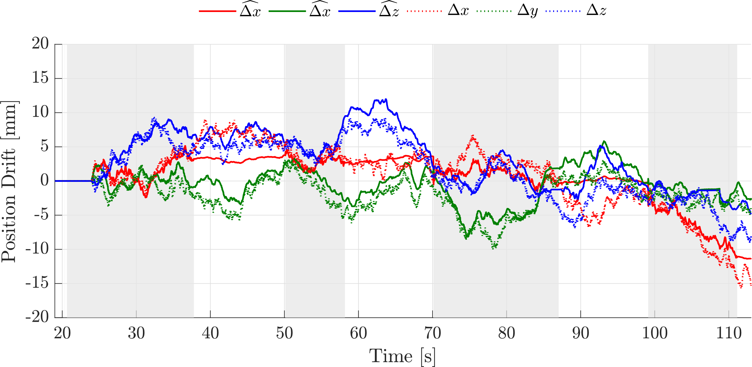
Results:
Combined Error Simulation and Rectification
Simulate | All
Estimate | All
Fig. 22: True and estimated MAV Position Drift with Estimator turned on.

Slide 42

Results:
Combined Error Simulation and Rectification
Simulate | All
Estimate | All
Fig. 23: True and estimated Whiteboard Orientation Offset with Estimator turned on.

Slide 43

Results:
Combined Error Simulation and Rectification
Simulate | All
Estimate | All
Fig. 24: True and estimated Servo Angle Offsets set with Relative Control turned on.

Slide 44

Results:
Combined Error Simulation and Rectification
Simulate | All
Estimate | None
Fig. 25: Visual Error with All Feedback Components being turned off.

Slide 45

Results:
Combined Error Simulation and Rectification
Simulate | All
Estimate | All
Fig. 26: Visual Error with All Feedback Components being turned on.

Slide 46

Results:
Combined Error Simulation and Rectification
Simulate | All
Estimate | All
Fig. 27: Box Plots with All Feedback Components being turned on.

Slide 47






Discussion:
Key Takeaways
General
Performance
Limitations
All Error Sources
removed effectively
Achieve millimetre-level Accuracy
Loss of Observability when not in Contact
Repeatable Method
Drastically improved Visual Appearance
Interference between Feedback Components

Slide 48





Discussion:
Future Work
Planned
Minor Improvements
Long-Term
Evaluation in real-world Aerial Writing Task
Scale Sensitive Template Matching
Tight Fusion of Measurements
Submit Results
to ICRA 2021
Wide FoV Camera for large Drawings
Full 6 DoF Estimation
using Dense Tracking

Slide 49
Conclusion – Contributions
I
II
III
Appearance-based Precision Evaluation for Aerial Writing
Multimodal Feedback for Aerial Writing
Simulation of Aerial Writing for Evaluation

Slide 50

Confidential
(under review)

Slide 51

Questions and Discussion
Confidential
(under review)

Slide 52

Backup
Backup Fig. 1: Illustration of Visual Measurement Model showing both the expected MAV pose (color, right) and actual MAV pose (greyscale, left)

Slide 53

Multimodal Feedback: MAV Position Drift Estimator
Filter Definition
Backup
$$K_{k}^{ }=P_{k|k−1}^{ }H_{k}^{T}{\left(H_{k}P_{k|k−1}^{ }H_{k}^{T}+R_{k}\right)}^{−1}$$
$${\hat{x}}_{k|k}^{ }={\hat{x}}_{k|k−1}^{ }+K_{k}\left(z_{k}−h\left({\hat{x}}_{k|k−1}^{ }\right)\right)$$
$$P_{k|k}^{ }=\left(I−K_{k}H_{k}\right)P_{k|k−1}^{ }$$
Multimodal Measurement function
$$h\left({\hat{x}}_{k|k−1}^{ }\right)=\left(\begin{matrix}h^{v}\left({\hat{x}}_{k|k−1}^{ }\right) \\ h^{t}\left({\hat{x}}_{k|k−1}^{ }\right)\end{matrix}\right)$$
Measurement update

Slide 54

Results:
MAV Position Drift Estimator
Backup
Simulate | Drift
Estimate | Nothing
Backup Fig. 2: True and estimated MAV Position Drift with Estimator turned off.

Slide 55

Results:
Whiteboard Orientation Estimator
Backup
Simulate | Whiteboard
Estimate | Nothing
Backup Fig. 3: True and estimated Whiteboard Orientation Offset with Estimator turned off.

Slide 56

Results:
Relative End Effector Position Control
Backup
Simulate | Servo
Estimate | Nothing
Backup Fig. 4: True and estimated Servo Angle Offsets with Estimator turned off.

Slide 57

Results:
MAV Position Drift Estimator
Backup
Simulate | Drift
Estimate | Nothing
Backup Fig. 5: Visual Error with MAV Position Drift Estimator being turned off.

Slide 58

Results:
MAV Position Drift Estimator
Backup
Simulate | Drift
Estimate | Drift
Backup Fig. 6: Visual Error with MAV Position Drift Estimator being turned on.

Slide 59

Results:
Whiteboard Orientation Estimator
Backup
Simulate | Whiteboard
Estimate | Nothing
Backup Fig. 7: Visual Error with Whiteboard Orientation Estimator being turned off.

Slide 60

Results:
Whiteboard Orientation Estimator
Backup
Simulate | Whiteboard
Estimate | Whiteboard
Backup Fig. 8: Visual Error with Whiteboard Orientation Estimator being turned on.

Slide 61

Results:
Relative End Effector Position Control
Backup
Simulate | Servo
Estimate | Nothing
Backup Fig. 9: Visual Error with Relative End Effector Position Control being turned off.

Slide 62

Results:
Relative End Effector Position Control
Backup
Simulate | Servo
Estimate | Servo
Backup Fig. 10: Visual Error with Relative End Effector Position Control being turned on.

Slide 63

Results:
Combined Error Simulation and Rectification
Backup
Simulate | All
Estimate | None
Backup Fig. 11: Actual Drawing on Whiteboard with All Feedback Components being turned off.

Slide 64

Results:
Combined Error Simulation and Rectification
Backup
Simulate | All
Estimate | All
Backup Fig. 12: Actual Drawing on Whiteboard with All Feedback Components being turned on.

